Slide 1
Advanced Tactical Training and Communications Search and Rescue
Search and Rescue Training

Slide 2
The following information is confidential and cannot be shared with anyone outside the training group.

Slide 3
Evidence collection or preservation

Slide 4
Forensic Identification Presentation

Slide 6
Evidence Collection
• Most errors occur when people collect evidence from a scene for a Forensic officer to process later on.
• Collection of wet evidence—such as bloody clothes, articles to be tested for DNA—such as coffee cups, pop bottles/cans, partially eaten food etc., shoes or boots.

Slide 7
Evidence Collection-cont’d
• If it is necessary to collect the evidence, in case weather will destroy potential DNA, then do so.
• Place article(s) in a paper bag, not a plastic bag. If plastic must be used, then do NOT seal the bag as plastic bags sealed will destroy fingerprint and DNA evidence.

Slide 8
Evidence Collection-cont’d
• If liquid is present in the container, you must not dump the liquid out. Try to keep the container upright until it can be turned over. If it has a lid, put the lid back on. DNA will be lost if the liquid is poured out.

Slide 9
Evidence Collection-cont’d
• Please wear gloves when handling evidence, preferably disposable nitrile gloves (Non-powdered), not the issued black gloves that come into contact with many contaminants. Gloves with powder inside are unacceptable.

Slide 10
Scene Preservation
• Preservation of evidence is paramount in order for Forensics to assist in the investigation.
• Be cognisant of rain, wind, snow—these events can quickly destroy the evidence you need Forensics to process.
• Footwear impressions can be covered with cardboard boxes, recycling bins, etc. with a rock or something of weight on top to keep them from blowing away.

Slide 11
Scene Preservation-cont’d
SUDDEN DEATH SCENES
• Occasionally, a person whom you are searching for may have killed themselves or died from the elements or natural causes.
• These scenes can be intimidating.
• Make great notes about what you observe.

Slide 12
Scene Preservation-cont’d
• You may have other civilians, paramedics, or firefighters entering the scene. Take all names of any who do enter the scene, or are attempting to enter.
• Report the names to the police when they arrive. If they refuse to give their names, advise the police; they will obtain their names.

Slide 13
Scene Preservation-cont’d
• When making notes, note the position of the body, clothing worn, lights on or off, room temperature—was it hot in the room or cold, windows open or closed—if indoor scene.

Slide 14
Scene Preservation-cont’d
• For outdoor scenes, note the weather conditions. They can change quickly. Note the direction that the wind is blowing, temperature as in cold, hot, or if you have a thermometer, the actual temperature, clothing worn.
• Location of any weapons or blood found at the scene.

Slide 15
Scene Preservation-cont’d
• Path you took to get to the deceased and what you touched or didn’t touch.
• If you touch something, note it and TELL us what you touched. It is imperative that we know what was touched and where you touched it.

Slide 16
Scene Preservation-cont’d
• We have received numerous fingerprint hits from crime scenes coming back to Officers working at the time. This is embarrassing to the Service and the Officer who deposited the print(s) on the evidence. It must be investigated and is very time consuming as it ties up investigators while eliminating these prints.

Slide 17
Scene Preservation-cont’d
FIRE SCENES
• All fire scenes belong to the Fire Dept/Fire Marshall until it is deemed that a Criminal Offence has occurred.
• You are there to help contain the scene until the police arrive.

Slide 18
Scene Preservation-cont’d
FIRE SCENES
• Make notes as to what you see while at the scene/or where evidence is found.
• Many times, the arsonist will be in the crowd. Note who is present by name or description. If possible do a slow video scan of the crowd. However, note your phone may be required for evidence.

Slide 20
Scene Preservation-cont’d
HANGINGS
• Occasionally, you will be looking for a missing person who was actually suicidal and may have killed themselves by hanging themselves.

Slide 21
Scene Preservation-cont’d
HANGINGS
• This can be very disturbing.
• Try to remain calm. Contact your command post and advise them exactly where you are and the status of the person hanging—is it an obvious death or could they still be alive due to recent hanging?

Slide 22
Scene Preservation-cont’d
HANGINGS
• Do NOT cut down the deceased if it is an OBVIOUS death. If deceased is to be cut down, cut between the noose and the area that the ligature is tied to or wrapped around, then loosen the ligature from around the neck—the ligature is the object used to hang themselves—rope, scarf, etc.

Slide 23
Scene Preservation-cont’d
HANGINGS

Slide 24
Scene Preservation-cont’d
HANGINGS
• Preservation of life is paramount. If the hanging person could still be alive, cut them down!!!
• Knot preservation is paramount for the coroner/pathologist to examine and determine if foul play has occurred.

Slide 25
Scene Preservation-cont’d
HANGINGS
• Note the clothing worn by the deceased.
• Note any obvious trauma to the body. Do NOT remove clothing to look for trauma, unless you have cut the deceased down and are going to perform CPR/life-saving measures.

Slide 26
Crime Scene or Not?
• How would you approach this scene?
• What protective clothing would you wear when entering the scene?
• What concerns would you have—your safety and well-being, the scene itself?
Notes:
Information is received that a male is found deceased on the stairs leading to the 3rd floor. There is blood everywhere!!

Slide 27
Scenario
• You are searching for a missing person who has an undetermined medical condition, and you observe that there is blood EVERYWHERE.
• They entered a building to get out of the elements and died.
• Why has this person died?

Slide 28
Scenario

Slide 29
Safety Concerns
• If you have booties, wear them as well.
• If not, boots should be decontaminated after clearing the scene.
• MAKE SURE that any search and rescue personnel who attended the scene are made aware of their exposure.

Slide 30
Safety Concerns
• Decontaminate afterwards, especially using hand sanitiser at the scene. Have clothing dry cleaned and make sure the dry cleaning tag states
EXPOSURE TO BIOHAZARD MATERIAL
for safety of the handler of the clothing.
• Advise the local Health Unit of the exposure.

Slide 31
Scenario
• These next slides are extremely graphic.
• You may find someone in these conditions.
• Stay calm and advise your base of your findings.

Slide 32
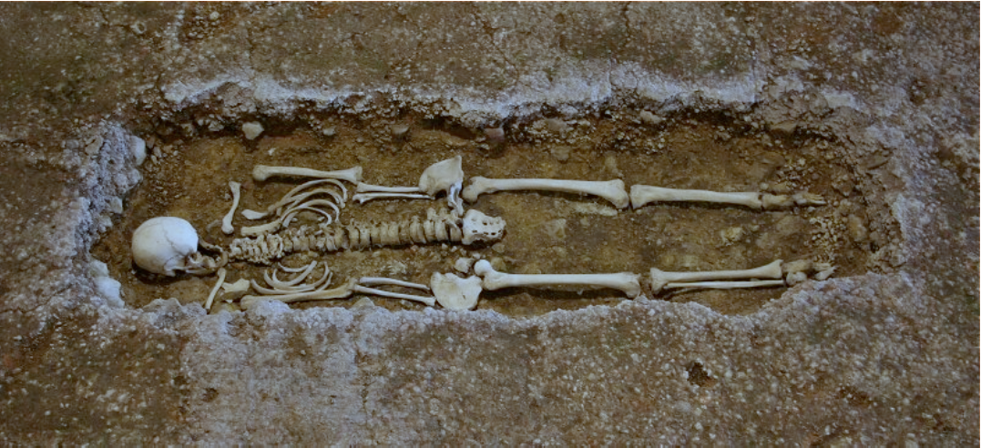
Forensic
Taphonomy
- Law of the Grave -

Slide 33
• The branch of palaeontology that deals with the processes of fossilisation.
• Forensic taphonomy investigates the factors which decompose the bodies and alter evidence which is subject to a medico-legal investigation.
Definition

Slide 34
• Fresh
• Bloated
• Active Decay
• Advanced Decay
• Skeletal / Dry
Stages of Decomposition

Slide 35
• Blood settles
• Rigour mortis
• Cells break down/release enzymes (autolysis)
•Production of acids and gases (putrefaction)
Fresh

Slide 36
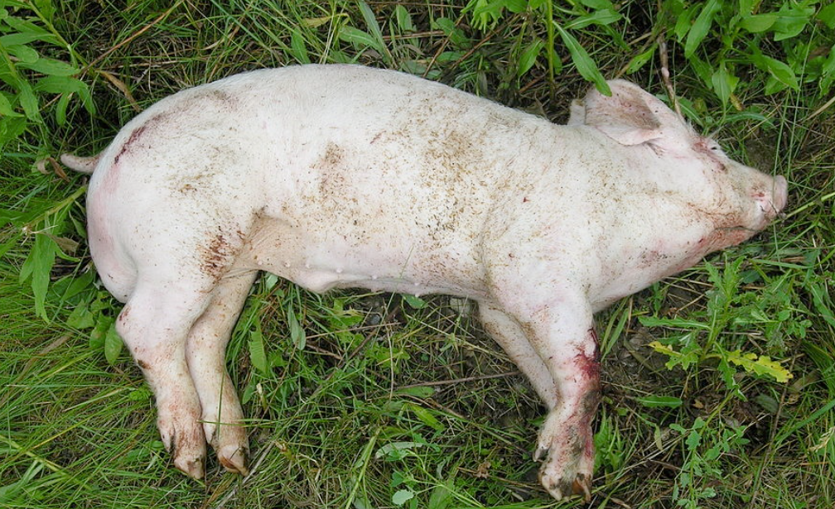
Fresh

Slide 37
• Gases build, distended appearance
• Skin colour changes, marbling (green, black)
• Maggots arrive
• Skin and hair slippage
Bloated

Slide 38
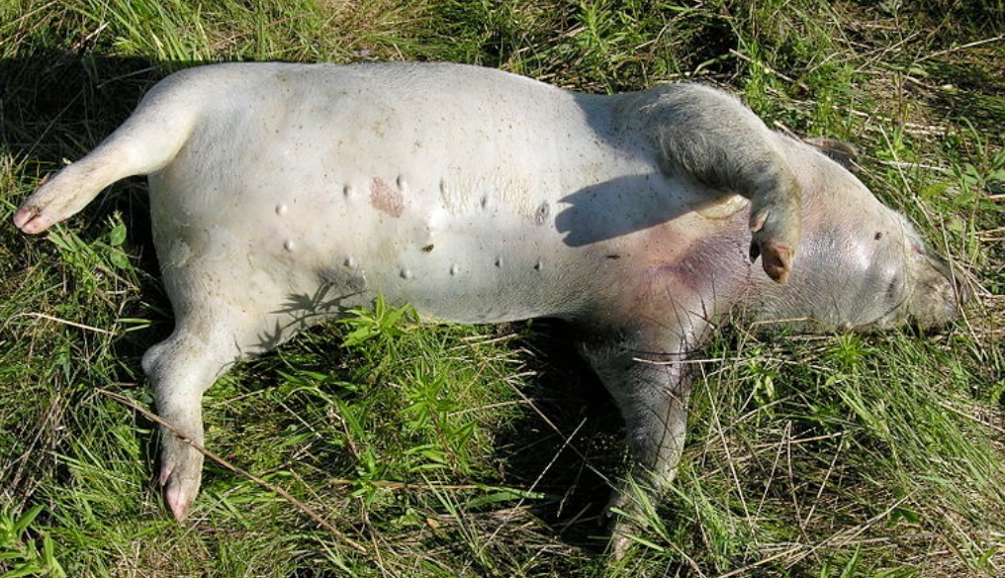
Bloated

Slide 39
• Loss of body mass and fluids via purge, insect or scavenger activity
• Large increase in maggots
• Increase in odour
Active Decay

Slide 40
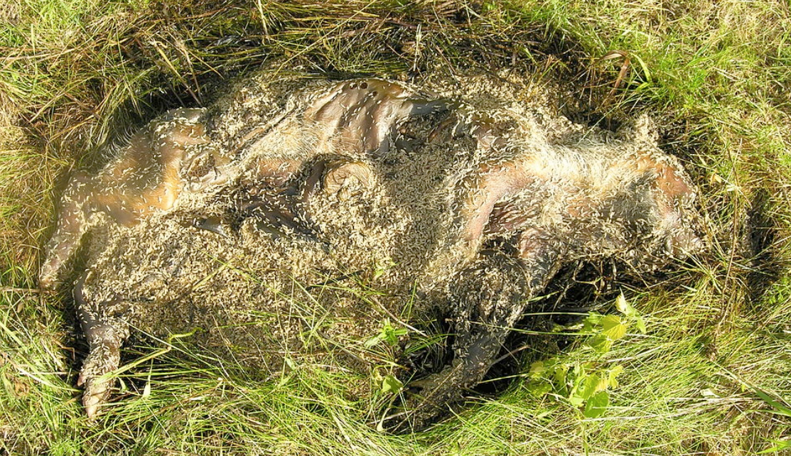
Active Decay

Slide 41
• Very little remaining body mass
• Soil staining, dead vegetation surrounding
• Maggots and flies depart
Advanced Decay

Slide 42
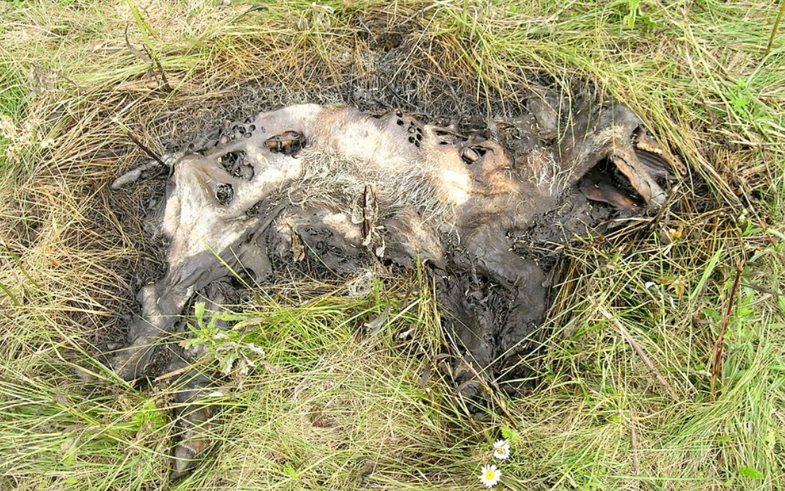
Advanced Decay

Slide 43
• Remaining skin is leathery and tough
• Only bones and connective tissue remain
• Bones will begin to bleach and crack
Dry / Skeletal

Slide 44
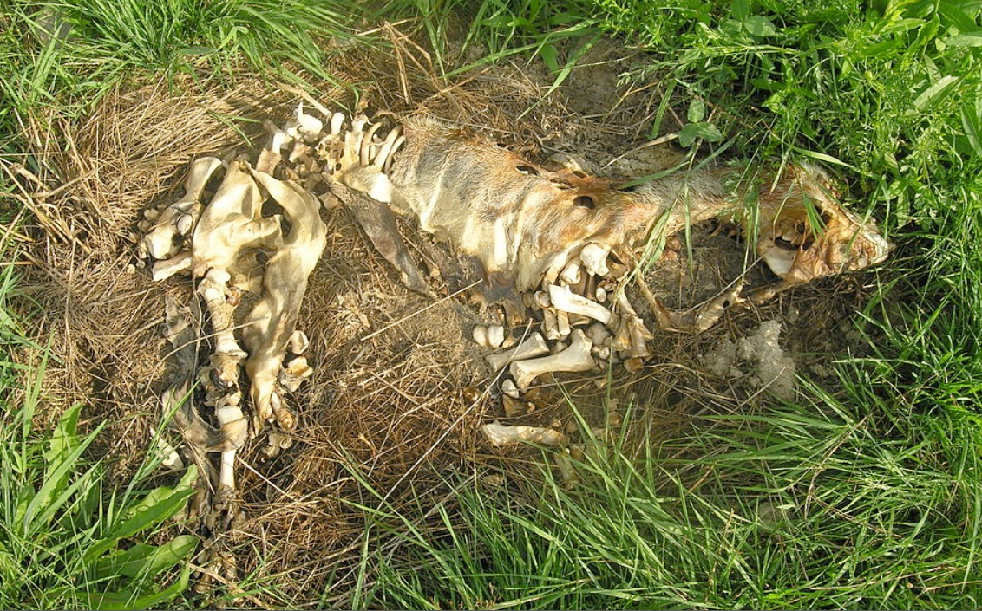
Dry / Skeletal

Slide 45
Another Crime Scene or Not?
• How would you approach this scene?
• What protective clothing would you wear when entering the scene?
• What concerns would you have—your safety and well-being, the scene itself?
Notes:
Information is received that a male is found deceased on the stairs leading to the 3rd floor. There is blood everywhere!!

Slide 46
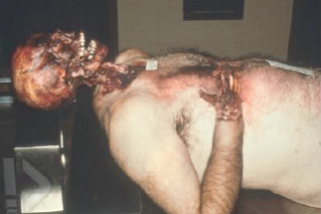
Another Crime Scene or Not?
Notes:
Information is received that a male is found deceased on the stairs leading to the 3rd floor. There is blood everywhere!!

Slide 47
• Temperature
• The availability of oxygen
• Prior embalming
• Cause of death
• Burial, depth of burial, and soil type
• Access by scavengers
Factors Affecting The Rate Of Decomposition

Slide 48
• Trauma, including wounds and crushing blows
• Body size and weight
• Clothing
• The surface on which the body rests
• Foods/objects inside the specimen's digestive tract
Factors Affecting The Rate Of Decomposition

Slide 49
• Organic substance formed by the anaerobic bacterial hydrolysis of fat in tissue
• Forms best in an environment with an absence of oxygen, high level of moisture
• Can persist for centuries
Adipocere (Grave Wax)

Slide 50
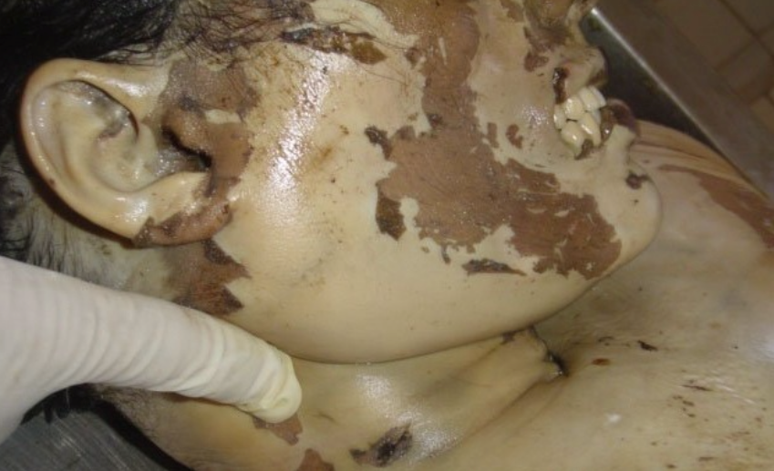
Adipocere On A Drowning Victim, Under Water For 7 Months

Slide 51
• In extremely dry or cold conditions, the normal process of decomposition is halted–by either lack of moisture or temperature controls on bacterial and enzymatic action–causing the body to be preserved as a mummy.
Mummification

Slide 52
• Frozen mummies commonly restart the decomposition process when thawed, whilst heat desiccated mummies remain so unless exposed to moisture.
Mummification

Slide 53
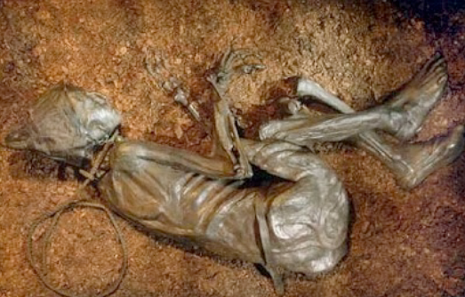
• Egyptian, naturally mummified by the desert.
Mummification

Slide 54
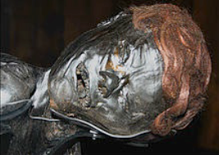
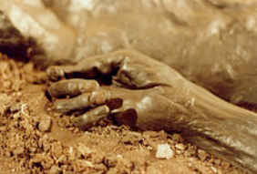
Grauballe Man
Died, approximately 300. BC
He was discovered 1952, in Denmark
Hand so perfectly preserved his fingerprints could be taken.
Bog Mummy

Slide 55
• Benzenes, fluoro compounds, naphthalene, mothball odour, chloroform, styrene .
• Carbon tetrachloride is #1, and is unique to human decomposition.
• Fluoride compounds (dichlorodiflouromethane)
• Cadaverine, putrescine assumed to be important BUT doesn’t surface from buried remains.
“Odour” Mortis (or what are they smelling?)

Slide 56
This concludes the lesson today.
Remeber.
This information is confidential and cannot be shared with anyone outside the training group.

