Slide 1
sUAS FOR SEARCH AND RESCUE
William Bolton

Slide 2
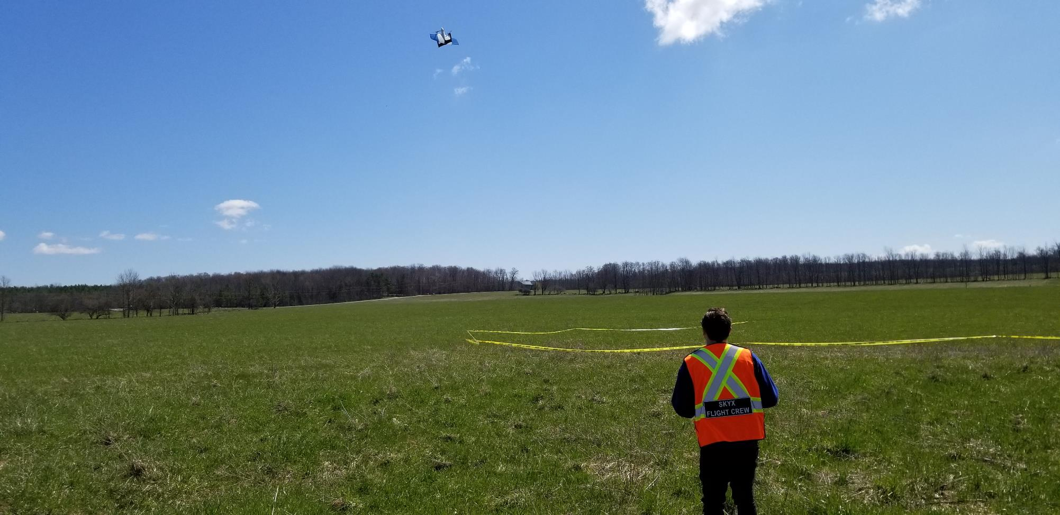
AGENDA
01
02
03
Current Ecosystem
Unmanned Systems
Use Cases and ConOps
Notes:
© Copyright Showeet.com

Slide 3
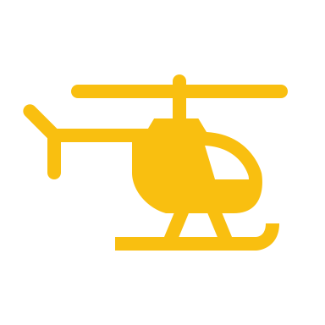
CURRENT ECOSYSTEM
There are a number of different groups used by emergency services for search and rescue efforts
Canine unit
Mounted unit
Ground unit
Marine unit
Aerial unit
Notes:
Note for Bill: Share a short description of what each unit does

Slide 4
AGENDA
01
02
03
Current Ecosystem
Unmanned Systems
Use Cases and ConOps

Slide 5
THE FUTURE IS UNMANNED SYSTEMS
Currently over 900 state and local police, fire and emergency units are equipped with drones
According to a recent study, teams equipped with drones find individuals 191 seconds faster than teams without drones
Drones are known to reduce costs, cut response times and share disaster recovery efforts with people
Notes:
Source: http://www.businessofgovernment.org/blog/drones-shine-emergency-management
These operations are also safer and more cost-effective than using manned aircraft. The savings were immediately apparent: the operating cost of a helicopter flight can run up to $600/hour, while UAS operations average $25/hour.

Slide 6
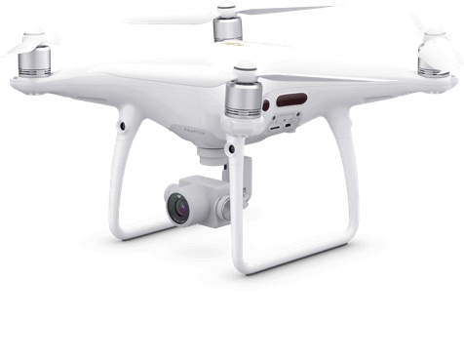
SYSTEMS IN USE TODAY
Yuneeq Typhoon H
FLIR SkyRanger
DJI Phantom 4 Pro
DJI M600
Notes:
Typhoon H
- Hexacopter offers increased redundancy compared to a quadcopter
Single person (pilot operates the camera) or two person (pilot + payload operator) control
Visible and IR camera options
SkyRanger
Specialized to meet the needs of defense and security agencies (but at a premium price tag upwards of $100’000 USD)
IP54 rated airframe
Up to 4.5 lbs payload capacity
Real-time onboard computer vision
DJI Phantom 4
Ubiquitous across the drone industry.
Up to 30 minutes flight time
1080P live streaming. Options for IR cameras
DJI M600
Industrial Heavy lift (up to 13 lbs) for up to 16 minutes. Basically the pickup truck of the commercial drone world.
Variety of payloads offered from DJI
Suitable for more complex operations where a drone may be required to deliver something to a person in need (supplies, life jacket, etc)

Slide 7
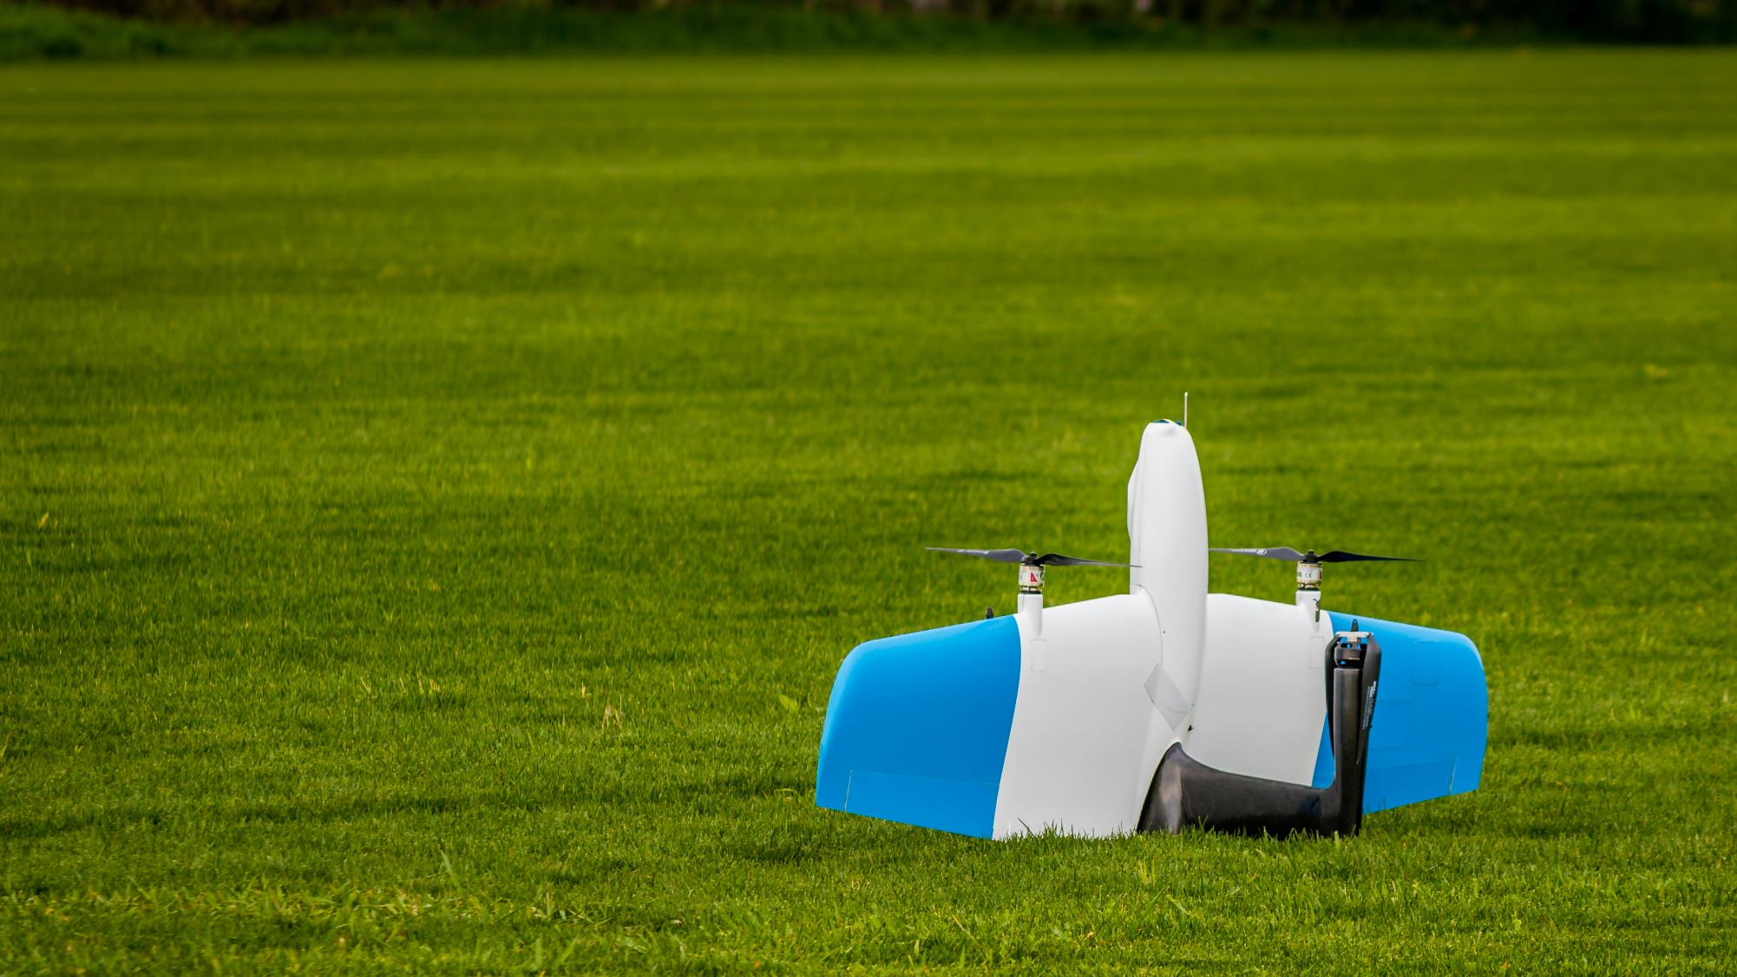
SKYONE
Purpose-built Vertical Takeoff and Landing (VTOL) fixed-wing aircraft
Industrial lithium ion power system
-11°F to 100°F
65 miles
40 – 75 mph
3G / 4G / Long Range RF / SATCOM
EO / IR Payloads
Notes:
SkyOne is best suited for missions which require an extended reach beyond the range or endurance of multirotor aircraft
Takeoff and land in the space of a multirotor, with the range benefits of a fixed wing aircraft.
Variety of redundant communication systems

Slide 8
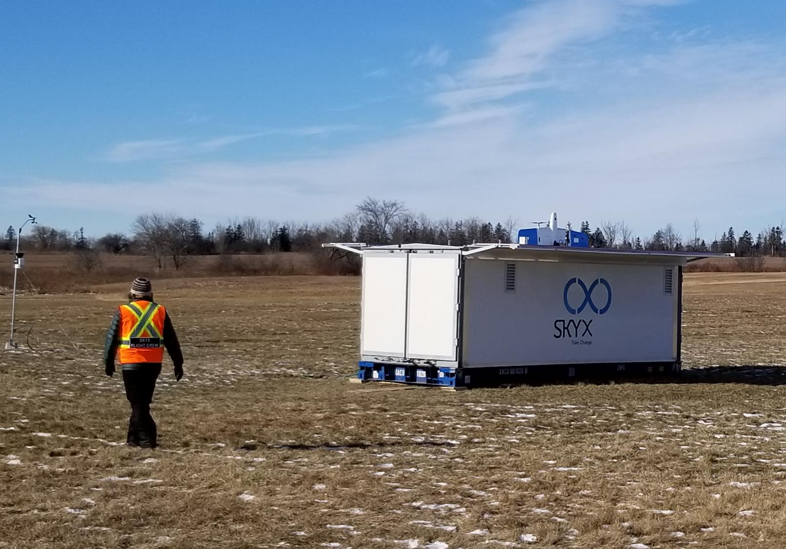
xSTATION
Optional launch and recovery station
Extended operational range
Faster deployment for routine operations
Increased remote autonomy

Slide 9
AGENDA
01
02
03
Current Ecosystem
Unmanned Systems
Use Cases and ConOps

Slide 10
USE CASE #1 – SEARCH AND RESCUE
CURRENT SYSTEMS
Multi-rotors used for live video and thermal and optical imaging
Limited by flight time and range
Time critical and ruling out areas
SKYONE
Extended flight time and range allows for greater coverage
Survey linear features such as shorelines, riverbeds, etc.
Survey outer limits of search radius to stop it from expanding with time
Notes:
Expanding search areas, “Just as important to rule out areas as covering areas, to make the best use of already limited resources” (Morris Hansen - VP of Douglas County, Colorado SAR)
large plots of land in minutes, in contrast to on-foot searches which can take hours to complete. With the ability to fly at low levels usually limited by a helicopter, a drone can provide crews with a high definition live-video feed that can be replayed in order to increase the chances of finding a victim. A thermal camera can also give crews the ability to search at night, and detect the heat signature of victims through areas of low visibility
Thermal and Visual (M600, Inspire 2, M210)
Time Critical nature, SkyOne check outer limits early to stop search area from expanding
<GM> compare using a drone to check a field of corn (great!) or a park of limited size to what SkyOne can do for SAR:
Riverbeds
Shorelines
Zig zagging massive areas like national parks or bodies of water

Slide 11
USE CASE #2 – DISASTER RECOVERY
CURRENT SYSTEMS
Drone pilots use a sUAS to assess damage to critical infrastructure, inform their recovery strategies, and broadcast footage to anxious homeowners.
In Fort Bend, UAS platforms provided high resolution video that assisted in search and rescue missions and relayed changing flood conditions.
Footage captured during the effort and published to YouTube not only built trust in the UAS program, but also served as a positive publicity tool, broadcasting the department’s emergency response actions to a wide audience.
SKYONE
Extended flight time and range allows for greater coverage
Customizable payload to better identify areas of concern

Slide 12
USE CASE #3 – HIGHWAY PATROL
CURRENT SYSTEMS
Highway patrol units or police departments currently using drones on a case-by-case basis to better assess collision damage or other emergency situations
Drone pilot has to be present at the scene to fly the vehicle
Limited by flight time and range
SKYONE
Extended flight time and range allows for greater coverage
SkyOne able to do traffic monitoring over vast distances
Autonomous system to reduce the reliance on manned operations at the scene; drone can be remotely dispatched from an xStation
Ongoing and proactive monitoring

Slide 13
USE CASE #4 – FOREST FIRE MONITORING
CURRENT SYSTEMS
Multirotors used for live video and thermal and optical imaging
Limited by flight time, range and only used once a fire is detected
Remote and large areas impacted
Landscape drastically changed
SKYONE
xStation set-up in highly prone and remote areas for rapid assessment and routine monitoring
Assess larger perimeters (planning, active fires, previously burned areas)
Notes:
Optical: live fire monitoring, as well as the initial survey of the area (environmental conditions, fuel type - mapping vegetation and density, fire perimeter, burn locations)
Thermal: hot spot detection (active fires and previously burned areas to avoid secondary burns), track the path of flames and plan out how to extinguish it, and quickly scan over large areas of ground for missing victims who could still be trapped,
Data and footage collected by a drone can also serve as an important asset when it comes to future investigations
Large advantage to assess areas on multi-fire start days (lightning strom rolls through and starts tens or hundreds of fires in one day)
Recon of larger areas to properly assess and relay info back to the fire centres for planning
Assessing the vegetation types (factor in determining speed and potential of burn rates) from the images
*If SkyOne could relay live weather info (windspeed, wind direction, temperature estimates) during flight would be a huge advantage for recon
*Would need active DAA to mitigate risks of helicopters also conducting recon and taxiing fire fighters
<GM> we’ve talked with a number of rural Fire departments who have talked about putting a station in their region, and having the ability to fly SO to the site of a fire as soon as it’s reported. This would allow them to see the heat signature, get a scope of the fire etc. before they can get to it (especially in remote areas)
<GM> also applicable in states / provinces with high risk Forest Fire seasons, we can help patrol areas or report on active fires

Slide 14
USE CASE #5 – EMERGENCY RESPONSE
CURRENT SYSTEMS
Multirotors used for updating and assessing routes (roads, trails, glacier crevasses, etc.)
Limited by flight time and range
Time critical and limited route options
SKYONE
Extended flight time and range allows for longer stretches to be assessed before ground teams head out
Proactive to help the reactive
Autonomous system to reduce the reliance on manned operations at the scene; drone can be remotely dispatched from an xStation
Notes:
Arctic, glacier crevasses, safe entry points for climbers (DJI M210)
Planning routes in areas with changing terrain due to washed out roads, landslides
Help predict areas of concern on crucial/ main routes
Collect data and put together updated trail locations that don't even exist on Google Earth
Proactive to help the reactive: Assessing routes to ensure they are maintained so less down time when Emergency Responders are deployed
Time critical: Can’t waste time taking a path that is washed out 30km down the road or trying to find a path that doesn’t exist
Limited route options: Some remote areas have limited options to get in and out, therefore they need to be maintained but that is time consuming

Slide 15
CONCEPT OF OPERATIONS (CONOPS)
Onsite SkyX Operators (Basic)
SkyX pilots accompany responders on joint operations
Portable Ground Control Station (GCS) enables rapid mission planning and deployment
Remote SkyX Operators (Intermediate)
Responders trained to assemble and prepare the vehicle for flight
SkyX pilots operate the vehicle remotely
Optional deployment of the xStation for autonomous launch and recovery
SAR Operation (Advanced)
Highly trained responders assume PIC responsibilities
Portable GCS enables rapid mission planning and deployment
SkyX pilots to authorize flight plans and monitor systems remotely

Slide 16
REGULATORY RESOURCES (FAA)
Part 107
Provides a broad range of permissions for small unmanned aerial systems (sUAS) flown within Visual Line of Sight (VLOS)
Operational limitations include:
Aircraft weight under 55 lbs
Daylight operations
No flights over people
400 AGL ceiling
Part 107 Waivers
Official approval for operations outside specific aspects of the regulations
Operators must demonstrate that they have adequate risk mitigation strategies in place
Common waivers:
Fly a UAS beyond the ability to clearly see it (107.31 – VLOS Operations)
Fly a UAS at night (107.29 – Daylight Operations)
Use a visual observer without following all requirements (107.33 – Visual Observer)
Fly a UAS over people (107.39 – Operation Over People)
Notes:
FAA Part 107 summary (Operational Limitations and Remote PIC) - https://www.faa.gov/uas/media/part_107_summary.pdf
Waivers - https://www.faa.gov/uas/commercial_operators/part_107_waivers/
LAANC and authorizations
https://www.faa.gov/uas/commercial_operators/part_107/
https://www.faa.gov/uas/programs_partnerships/data_exchange/
FAA Drone Zone - https://faadronezone.faa.gov/#/
BVLOS - http://interactive.aviationtoday.com/avionicsmagazine/october-2019/detecting-the-path-to-bvlos-operations-for-commercial-drones-in-us-airspace/
DAA Kansas State - Casia by IRIS automation (300g and <$10,000), Using a limited dictionary of reaction maneuvers
Unmanned Traffic Management (UTM) System approving and re-routing flights in an automated fashion but DAA capability still necessary (complimentary systems)
December 2019 - FAA regulatory framework for remote drone identification
Presentation on BVLOS waivers from FAA UAS symposium - https://www.faa.gov/uas/resources/events_calendar/archive/2019_uas_symposium/media/How_To_Get_Approval_to_Fly_BVLOS-Part_107.pdf

Slide 17
REGULATORY RESOURCES (FAA)
Resources
FAA Part 107 summary (Operational Limitations and Remote PIC)
https://www.faa.gov/uas/media/part_107_summary.pdf
Part 107 Waivers
https://www.faa.gov/uas/commercial_operators/part_107_waivers/
LAANC and authorizations
https://www.faa.gov/uas/commercial_operators/part_107/
https://www.faa.gov/uas/programs_partnerships/data_exchange/
FAA Drone Zone
https://faadronezone.faa.gov/#/
BVLOS Waivers
BVLOS Waiver Presentation
BVLOS Case Study
Notes:
This is going to need some work …
FAA Part 107 summary (Operational Limitations and Remote PIC) - https://www.faa.gov/uas/media/part_107_summary.pdf
Waivers - https://www.faa.gov/uas/commercial_operators/part_107_waivers/
LAANC and authorizations
https://www.faa.gov/uas/commercial_operators/part_107/
https://www.faa.gov/uas/programs_partnerships/data_exchange/
FAA Drone Zone - https://faadronezone.faa.gov/#/
BVLOS - http://interactive.aviationtoday.com/avionicsmagazine/october-2019/detecting-the-path-to-bvlos-operations-for-commercial-drones-in-us-airspace/
DAA Kansas State - Casia by IRIS automation (300g and <$10,000), Using a limited dictionary of reaction maneuvers
Unmanned Traffic Management (UTM) System approving and re-routing flights in an automated fashion but DAA capability still necessary (complimentary systems)
December 2019 - FAA regulatory framework for remote drone identification
Presentation on BVLOS waivers from FAA UAS symposium - https://www.faa.gov/uas/resources/events_calendar/archive/2019_uas_symposium/media/How_To_Get_Approval_to_Fly_BVLOS-Part_107.pdf

Slide 18
Questions? William Bolton Senior Trainer Advanced Tactical Training Search & Rescue wbolton@attsar.ca

