Slide 1
Ground Penetrating Radar For Forensic Investigations

Slide 3
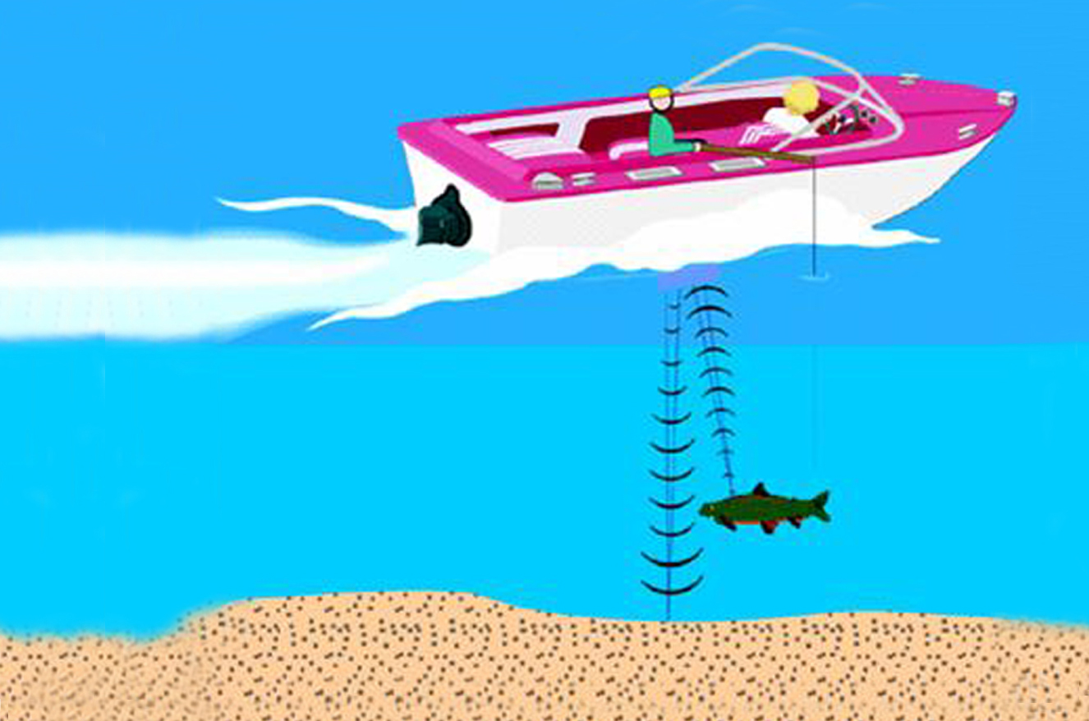
GPR works like a Fish-finder
Sends out a ping
Signal scattered back from fish
Signal scattered back from bottom
A single record has 2 blips

Slide 4
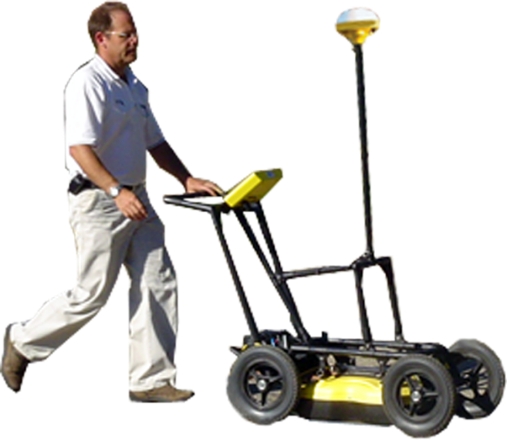
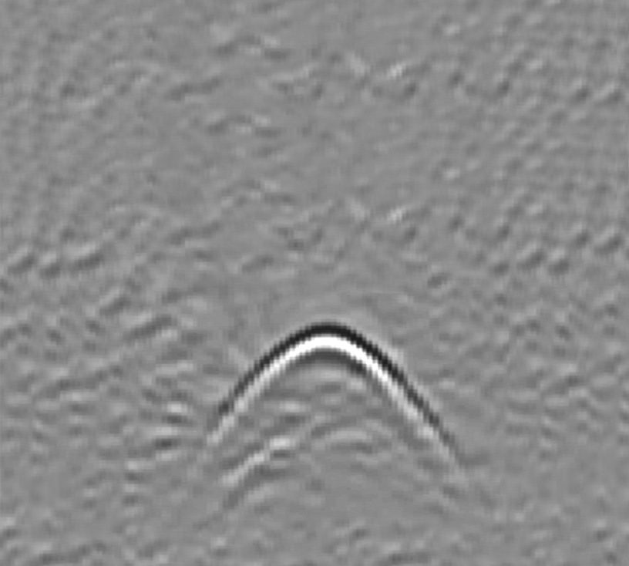
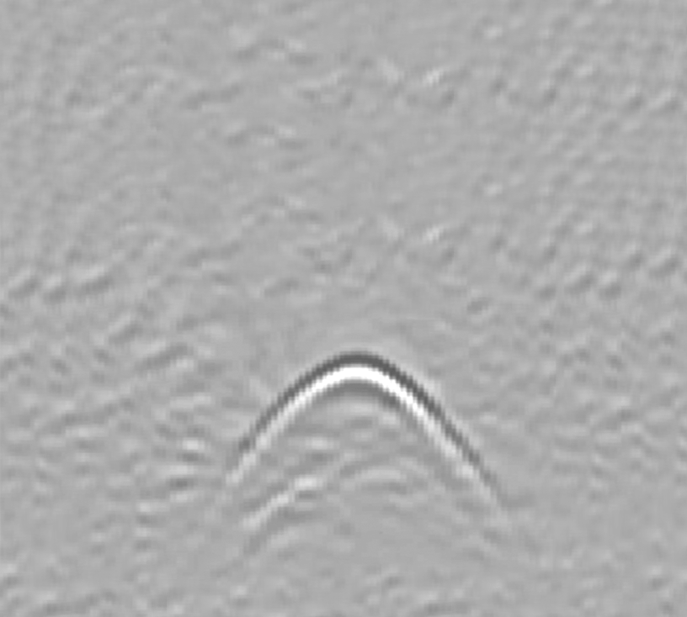
GPR Images the Subsurface
acronym for Ground Penetrating Radar
“ground” can be soil, rock, concrete, wood, anything non-metallic
emits a pulse of radio energy into the ground
record echoes
builds an image from the echoes
Notes:
The Noggin uses advanced impulse radar sensing technology.
Radio waves are generated and detected by the Noggin.
The buried targets are identified by the signals they reflect back to the surface and which are detected by the sensitive Noggin receiver electronics.
All Sensors & Software products are certified to meet regulatory standards around the world. See the FCC label or the CE mark on the labels and serial number plates.
Is the Noggin the universal answer. No! Some soils strongly absorb radio signals and exploration depth is limited. Just think about how well you cell phone or car radio work in underground garages or tunnels. Again, don’t get too involved in this discussion at this point but we need to have the response ready if some one asks. The point we want to get across is that the physics of radio waves limits exploration depth – not the product!. And no one can not increase power indefinitely. First the regulators will catch you out and second the power supply becomes prohibitively large and unwieldy.
This simple animation shows how an “inverted V” (hyperbola in space time) is created when traversing over a pipe.
The apex of V is the point of closest approach to the target. Moving to the top of the inverted V defines the location of the target.
Depth of the target is measured at the top of V. The standard depth calibration gives useful depth estimates. More accurate depths are obtained by using the target fitting feature built into the DVL software right on the unit.

Slide 5
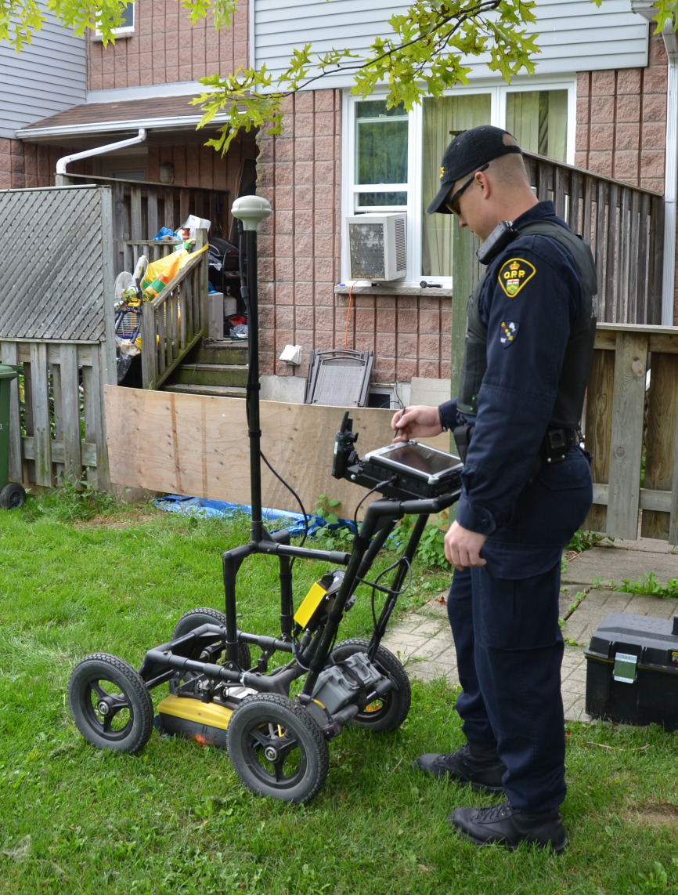
GPR Capabilities
GPR can tell that something is there because of the reflection of the waves.
GPR cannot identify exactly what the object is.
Notes:
AP

Slide 6
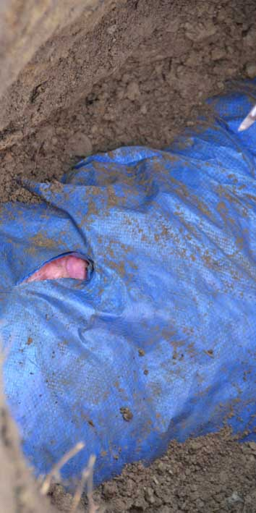
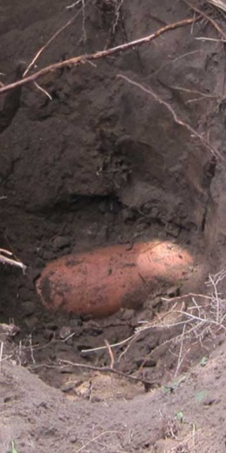
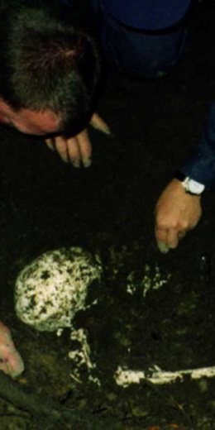
Primary items
Bodies
(in various stages
of decomposition)
Notes:
AP

Slide 7
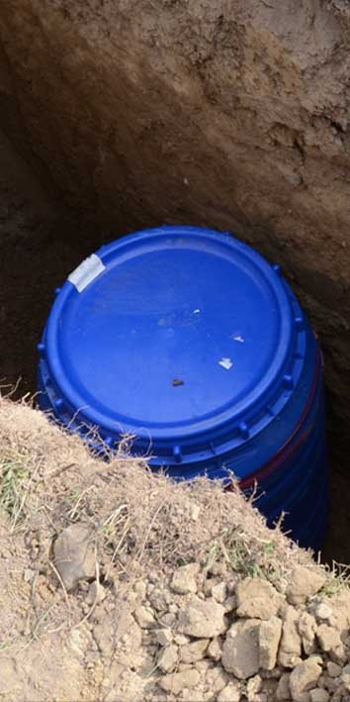
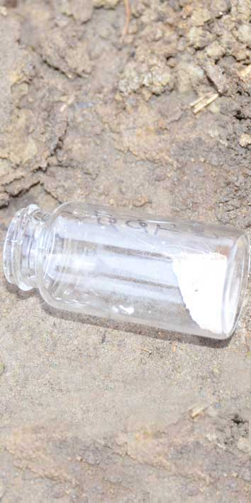
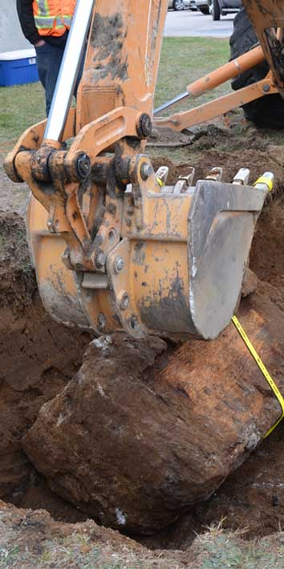
Primary items
Underground Storage
Containers
(metal, plastic, concrete, wood)
Notes:
AP

Slide 8
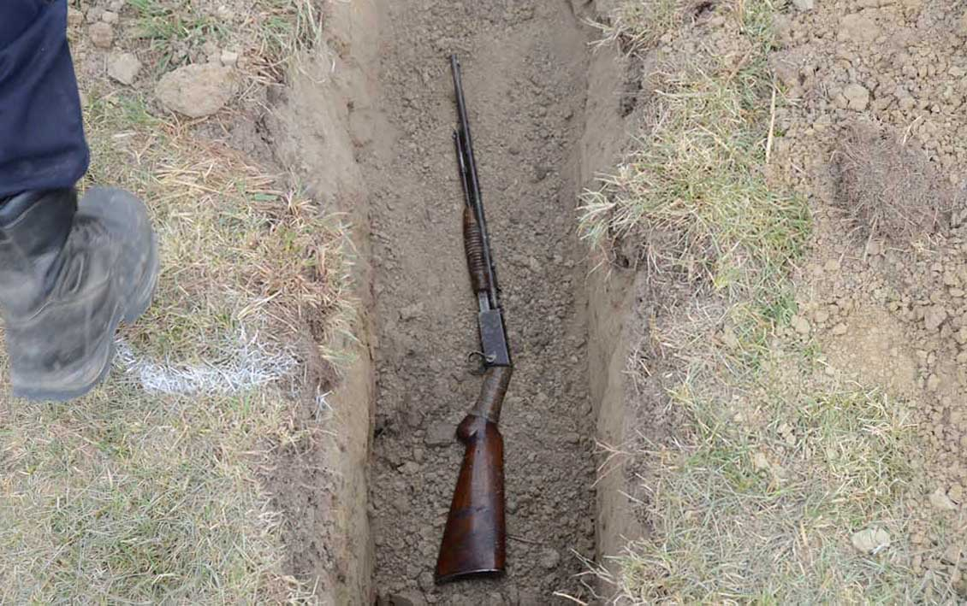
Primary items
Weapons
(metal, plastic, wood)
Notes:
AP

Slide 9
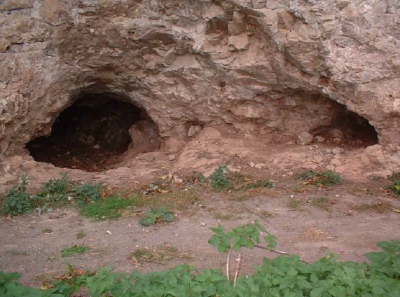
Primary items
Tunnels
Notes:
AP

Slide 10
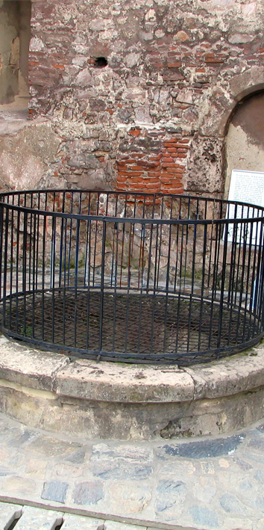
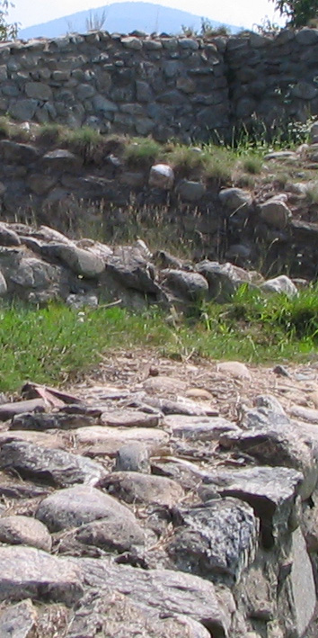
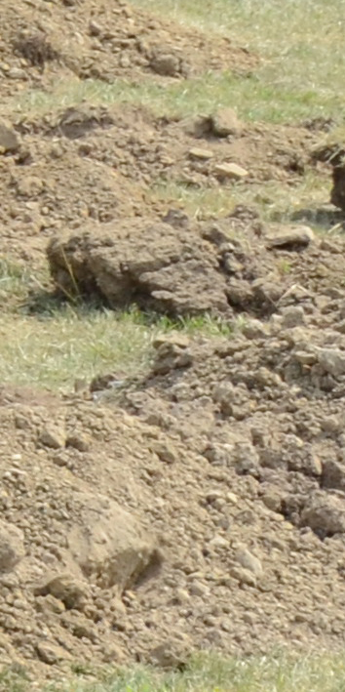
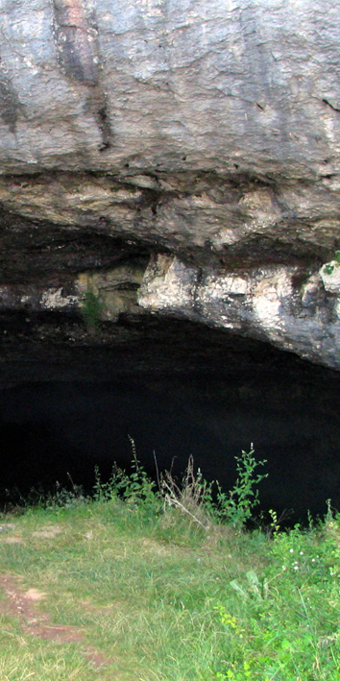
Secondary items
Wells
Foundations
Disturbed
Soil
Voids

Slide 11
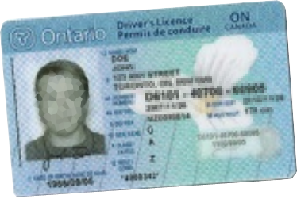
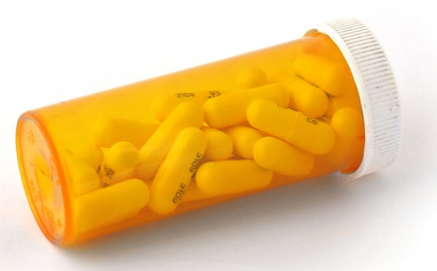
Impossible items
Small individual objects

Slide 12
GPR Limitations:
Cannot see through metal
Cannot see deep through certain types of soils
Finite depth detection
Finds non-evidence items
Cannot find very small items

Slide 13
FINDAR GPR
Display Unit
Collection Cart
Battery
Odometer
Transmitter and Receiver

Slide 14
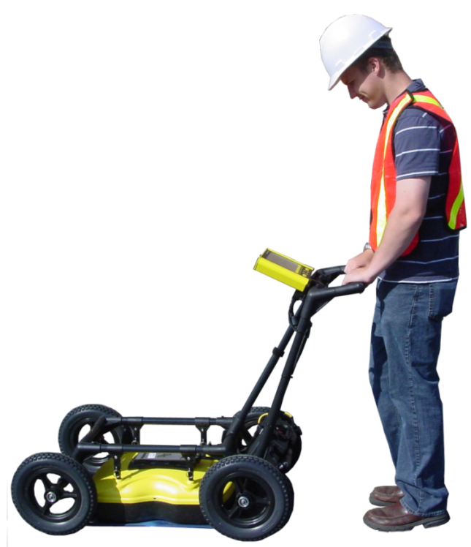
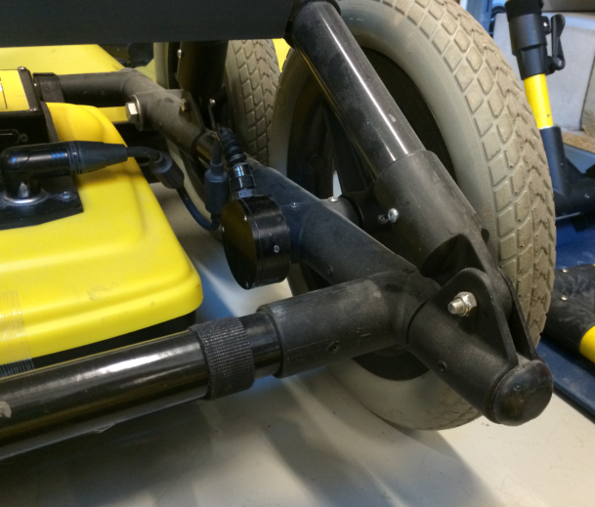
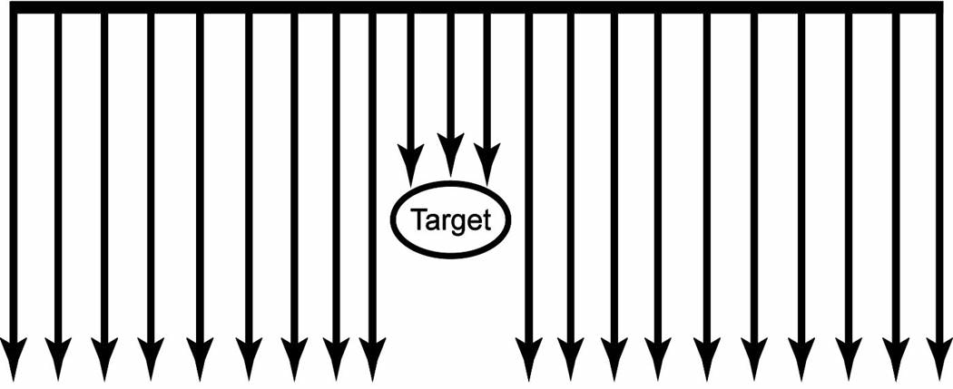
FINDAR Data Collection
Odometer
The odometer triggers the GPR system to take a data sample at regular intervals on the ground

Slide 15
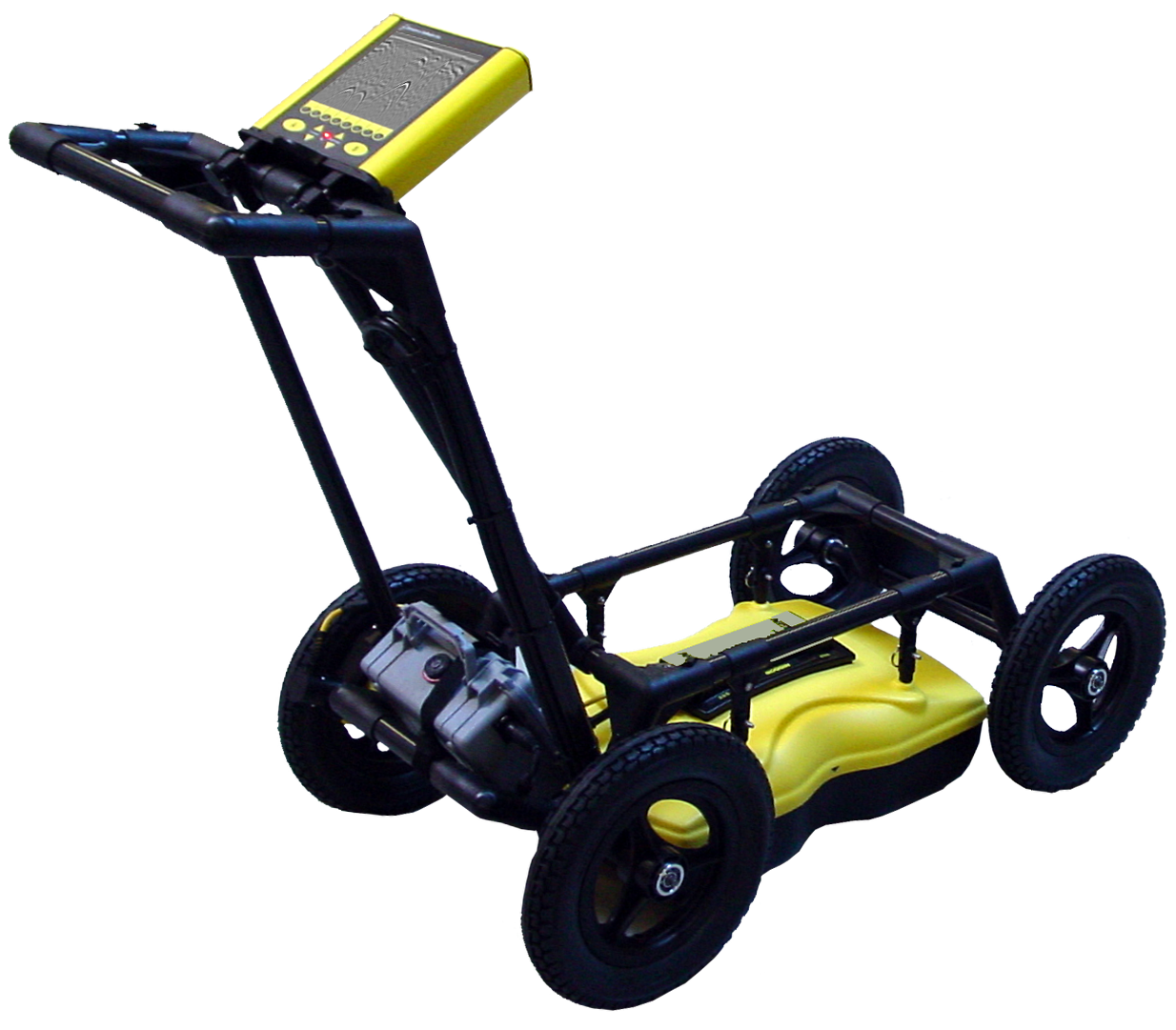
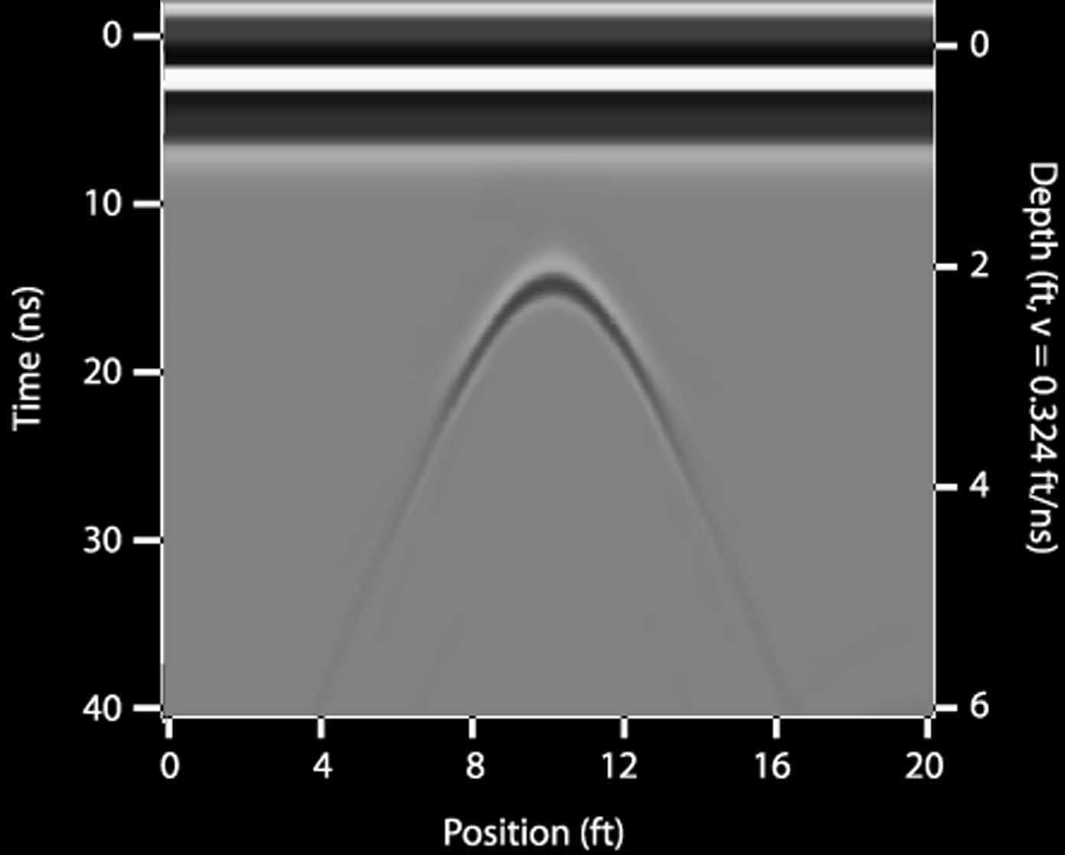
Point Targets Produce Hyperbolas
Target is approximately 2.2 ft. deep
Notes:
GPR uses a transmitter to send radio frequency electromagnetic waves into the subsurface and a receiver to collect the signals that reflect back to the surface from objects or materials with contrasting electrical properties. Data are typically recorded at multiple positions along a survey line on the surface which then produces a hyperbolic response

Slide 16
Line Search

Slide 17
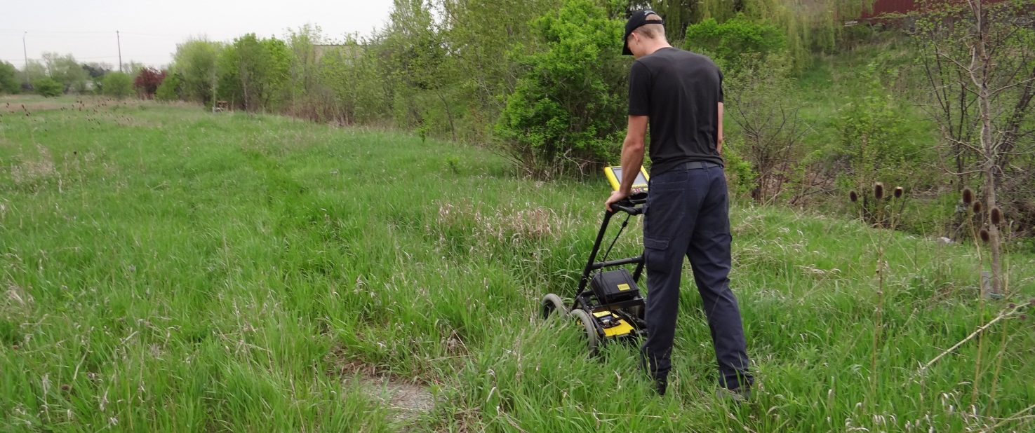
Line Search
Collecting lines in a unidirectional path
Notes:
You can search this way – click on, or this way – click or this way- click on
Let’s search this way – click on

Slide 18
Grid Search

Slide 19
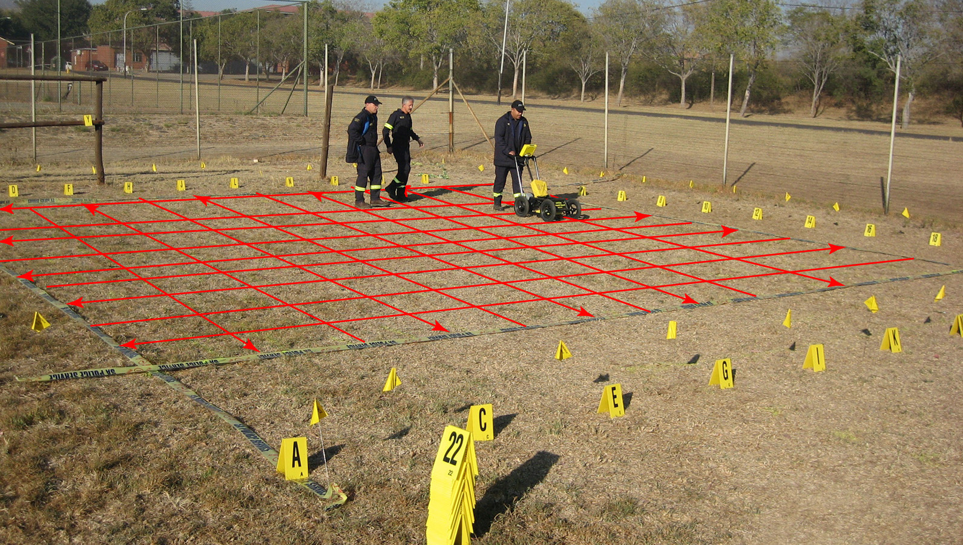
Collect multiple cross-sections in a grid

Slide 20
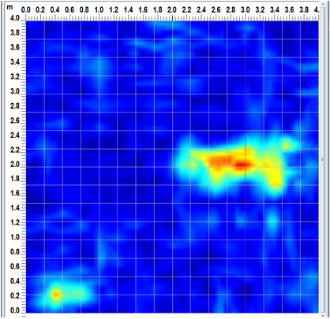
Depth Slices
Grid searches allow for data interpolation between lines to generate “depth slices”
Notes:
Conquest enables you to view different depth slices through concrete, right after scanning a grid.

Slide 21
GPR Case Studies
Notes:
SH

Slide 22
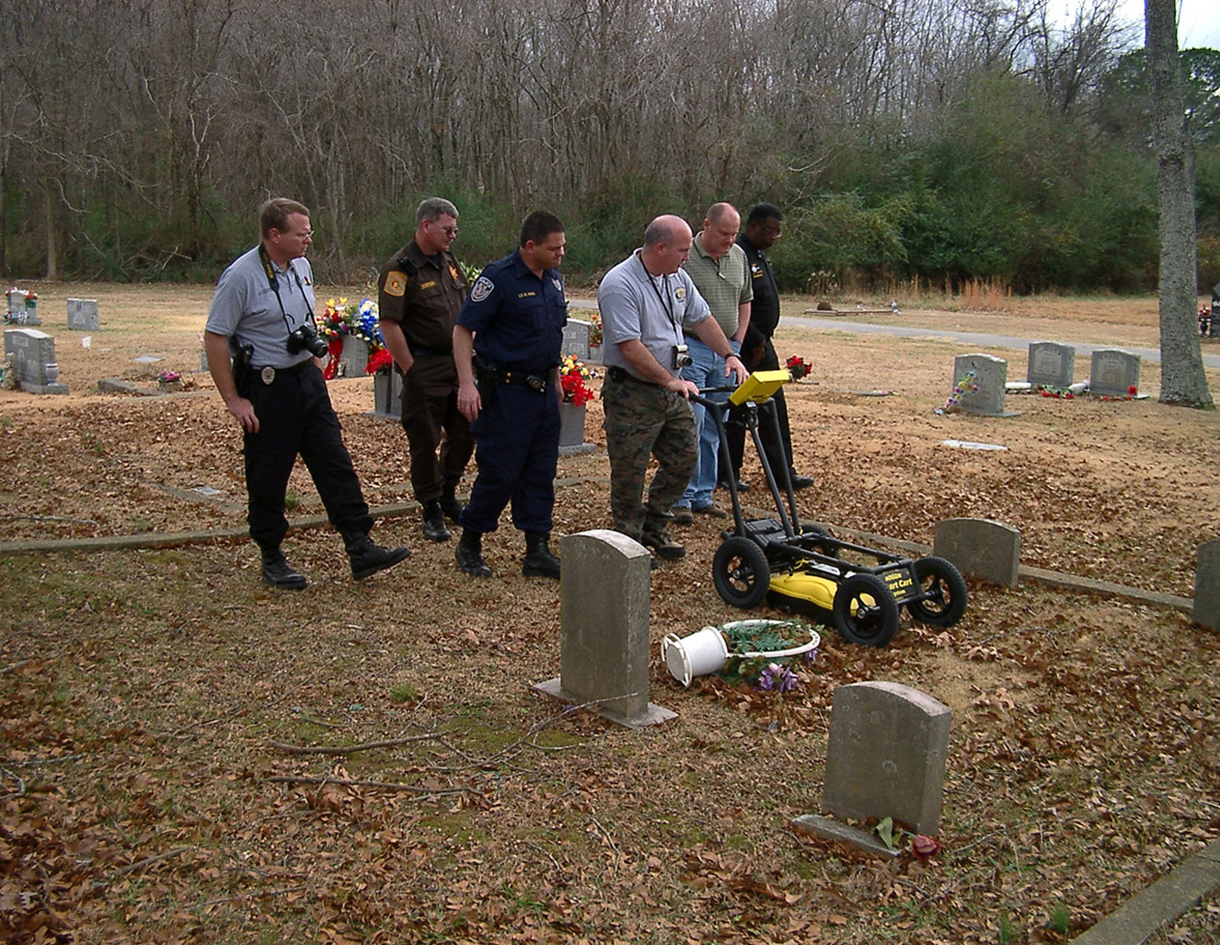
Graveyard mapping

Slide 23
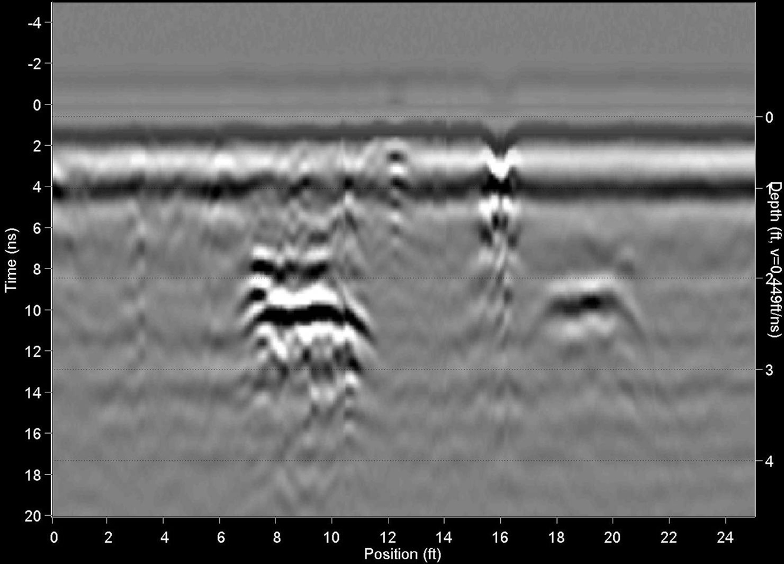
Graveyard Mapping

Slide 24
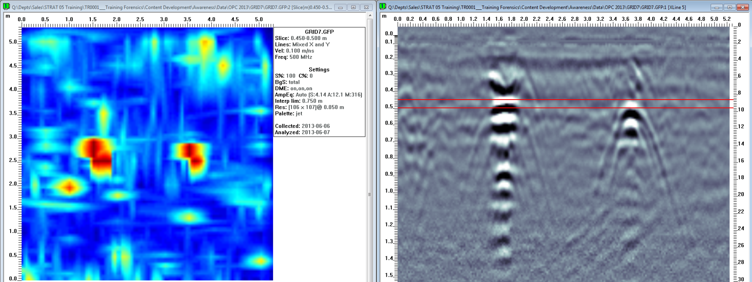
Test Site
Notes:
SH

Slide 25
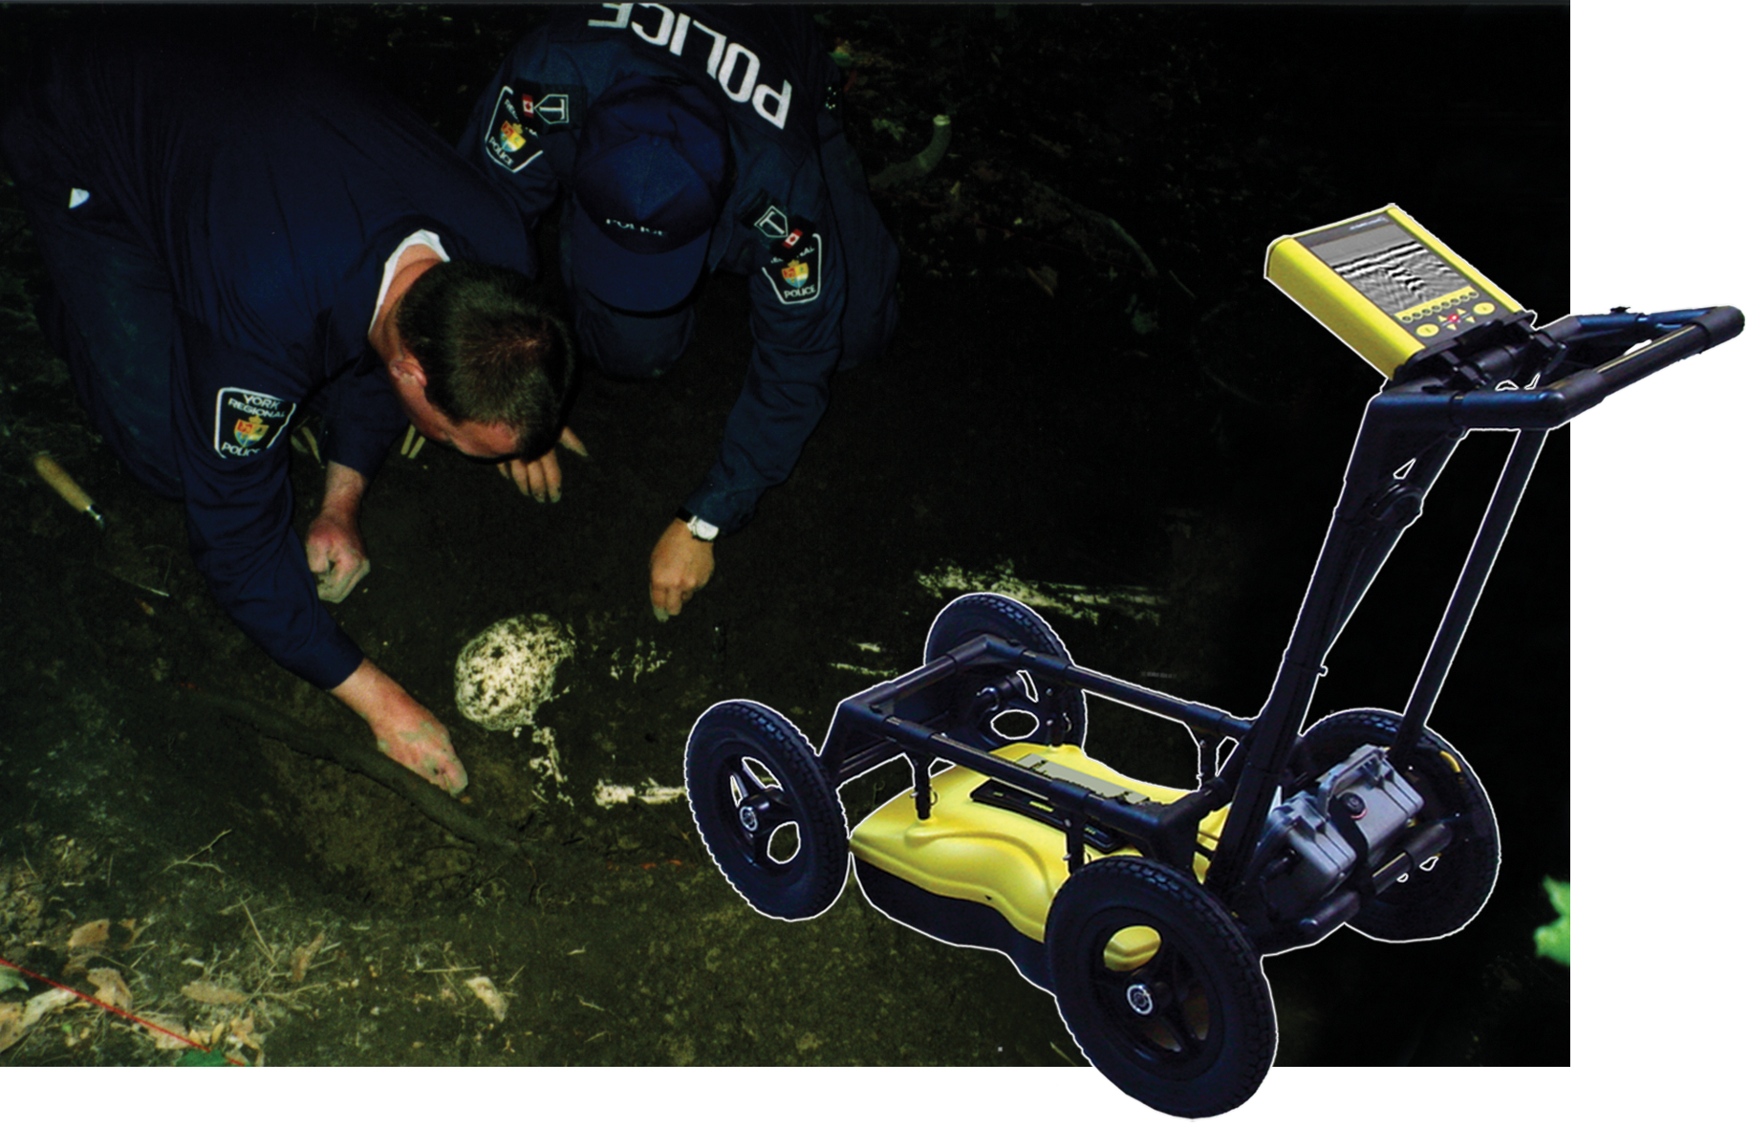
Clandestine Burials
Notes:
York Regional Police Anthropological Short Course, where GPR was used to help locate suspected areas of a staged clandestine burial.

Slide 26
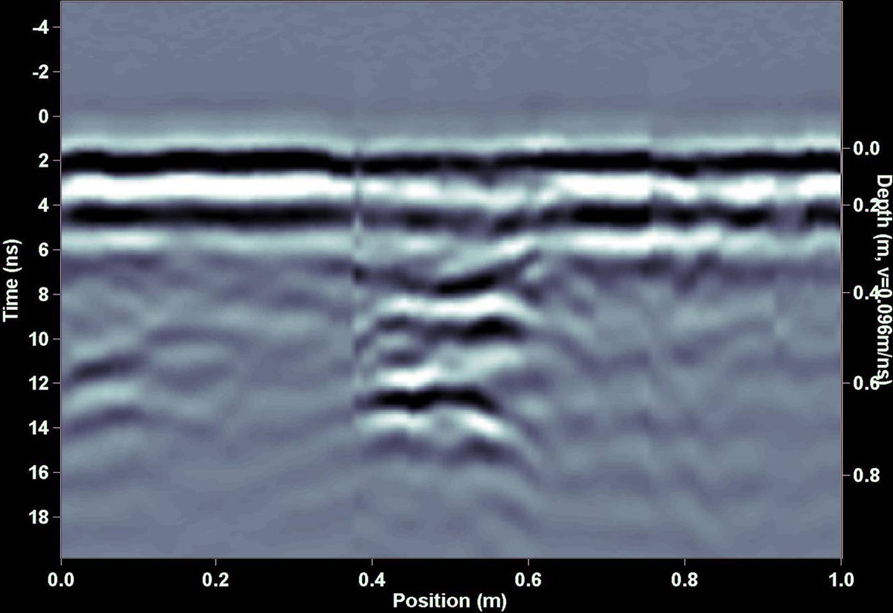
Buried Pig at 0.5 m deep
Notes:
Data from the Noggin 500 Plus SmartHandle system. The arrow indicates an area where the soil has been disturbed. The strong, lower reflector is the bottom of the grave, where the disturbed soil ends and the original soil begins. In the Toronto area, there is often a hard clay pan layer that GPR cannot penetrate through, so as soon as you see an area that has penetration beyond that layer, it would warrant further investigation. Notice that the buried pig does not provide a strong reflection itself. Once a human (or animal) body has decayed, the remains have similar properties to the surrounding soil. GPR needs a contrast in the electrical properties to produce a reflection from a target. Clothing and other items buried with the body may provide enough contrast to produce a reflection. As well, a freshly buried body, which is essentially a “bag of water” will produce a stronger reflection than a decayed body.

Slide 27
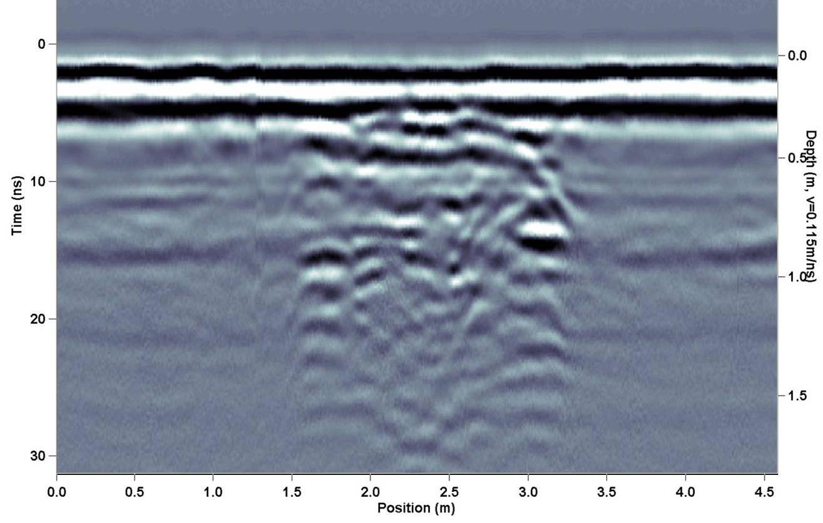
Disturbed Soil / Clandestine Burial

Slide 28
Clandestine burial
Cross Section
Plan Map
Notes:
AP

Slide 29
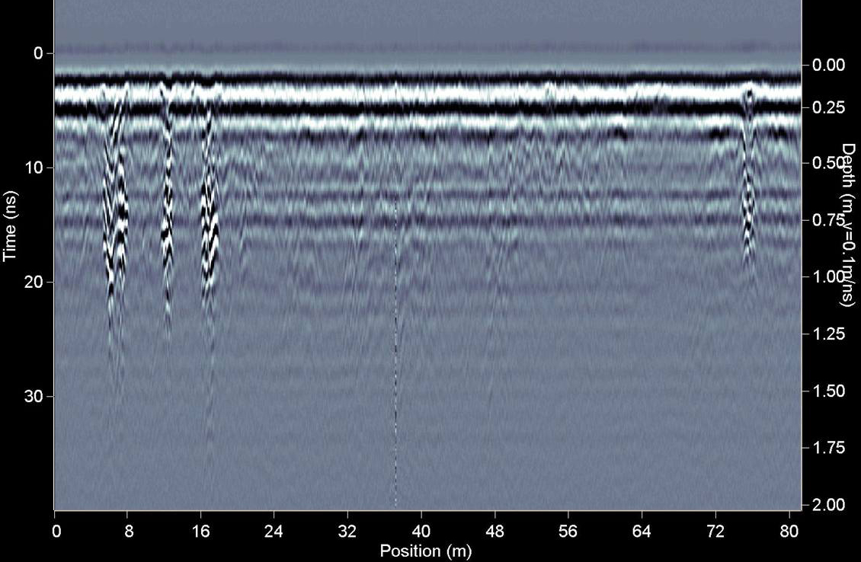
Forensic Anomalies
1
2
3
4
Notes:
Data from the Noggin 500 Plus SmartHandle system. The arrow indicates an area where the soil has been disturbed. The strong, lower reflector is the bottom of the grave, where the disturbed soil ends and the original soil begins. In the Toronto area, there is often a hard clay pan layer that GPR cannot penetrate through, so as soon as you see an area that has penetration beyond that layer, it would warrant further investigation. Notice that the buried pig does not provide a strong reflection itself. Once a human (or animal) body has decayed, the remains have similar properties to the surrounding soil. GPR needs a contrast in the electrical properties to produce a reflection from a target. Clothing and other items buried with the body may provide enough contrast to produce a reflection. As well, a freshly buried body, which is essentially a “bag of water” will produce a stronger reflection than a decayed body.

Slide 30
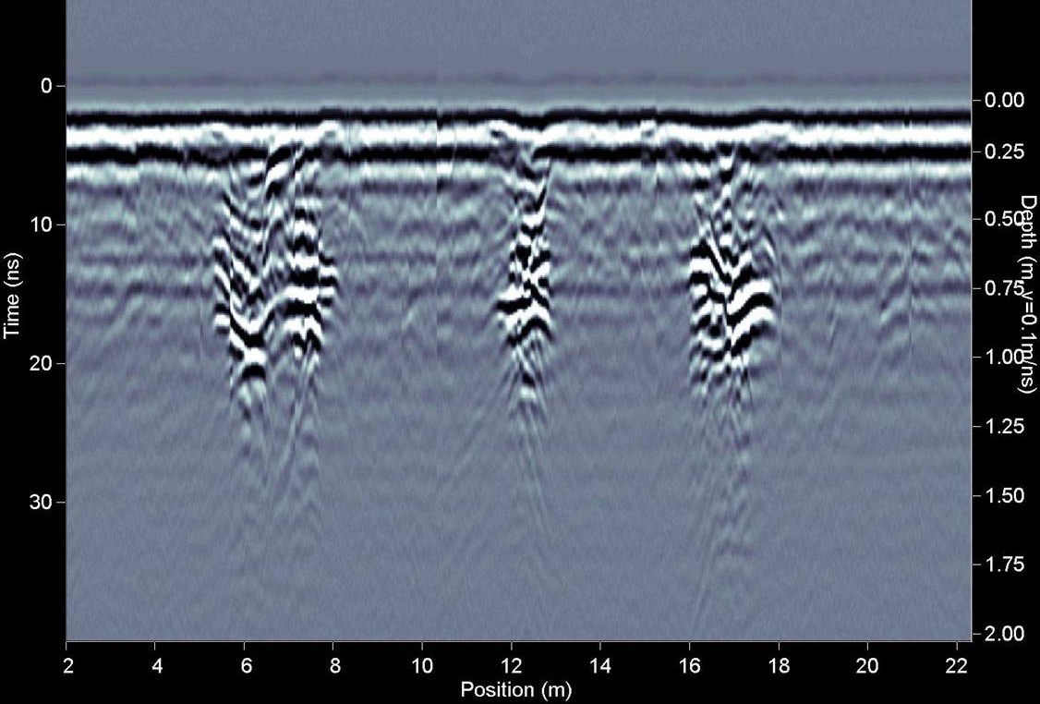
Zoom In

Slide 31
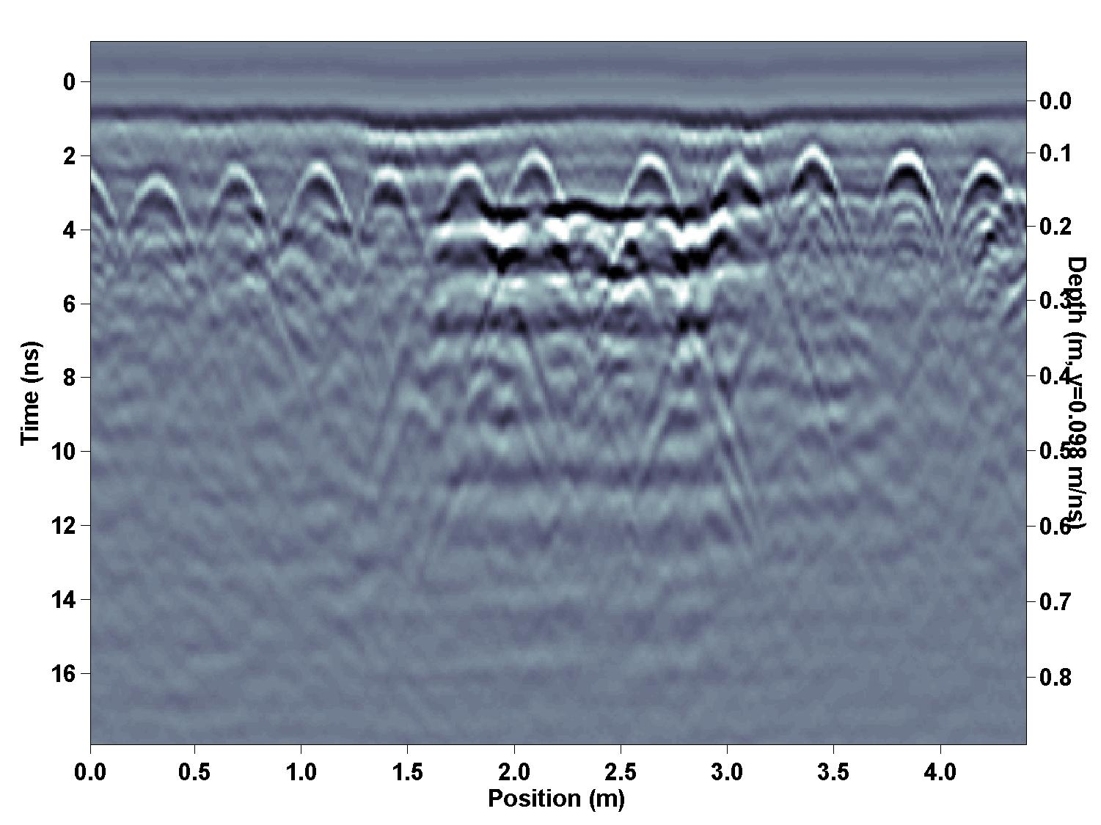
Suspicious area under concrete slab
Possible
Void

Slide 32
Suspicious area under concrete slab
Possible target of interest

Slide 33
GPR Summary
Rapid acquisition, easy-to-use, portable
Real-time results and plot as 2D maps and 3D volumes
Sees both metal and non-metal objects
Not the “silver bullet”; some areas are better than others
Enhances investigations; optimizes valuable resources

Slide 34
Questions and Discussion

Slide 35
Thank you for attending
Please contact us if you have further questions…

