Slide 1
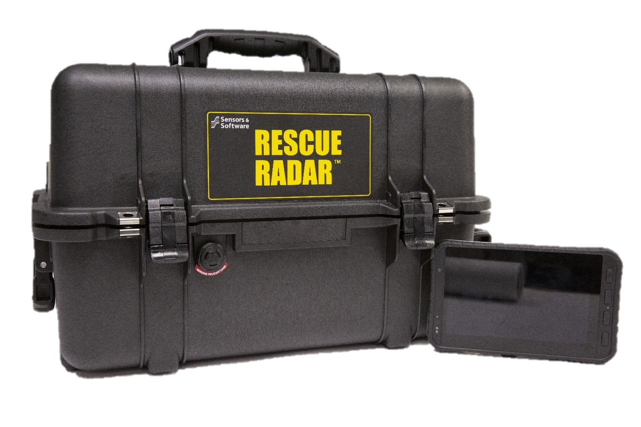
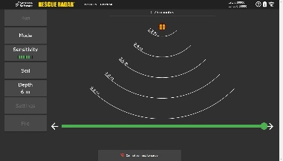
Rescue Radar™

Slide 2
Agenda
Rescue Radar Operation Overview
Questions

Slide 3
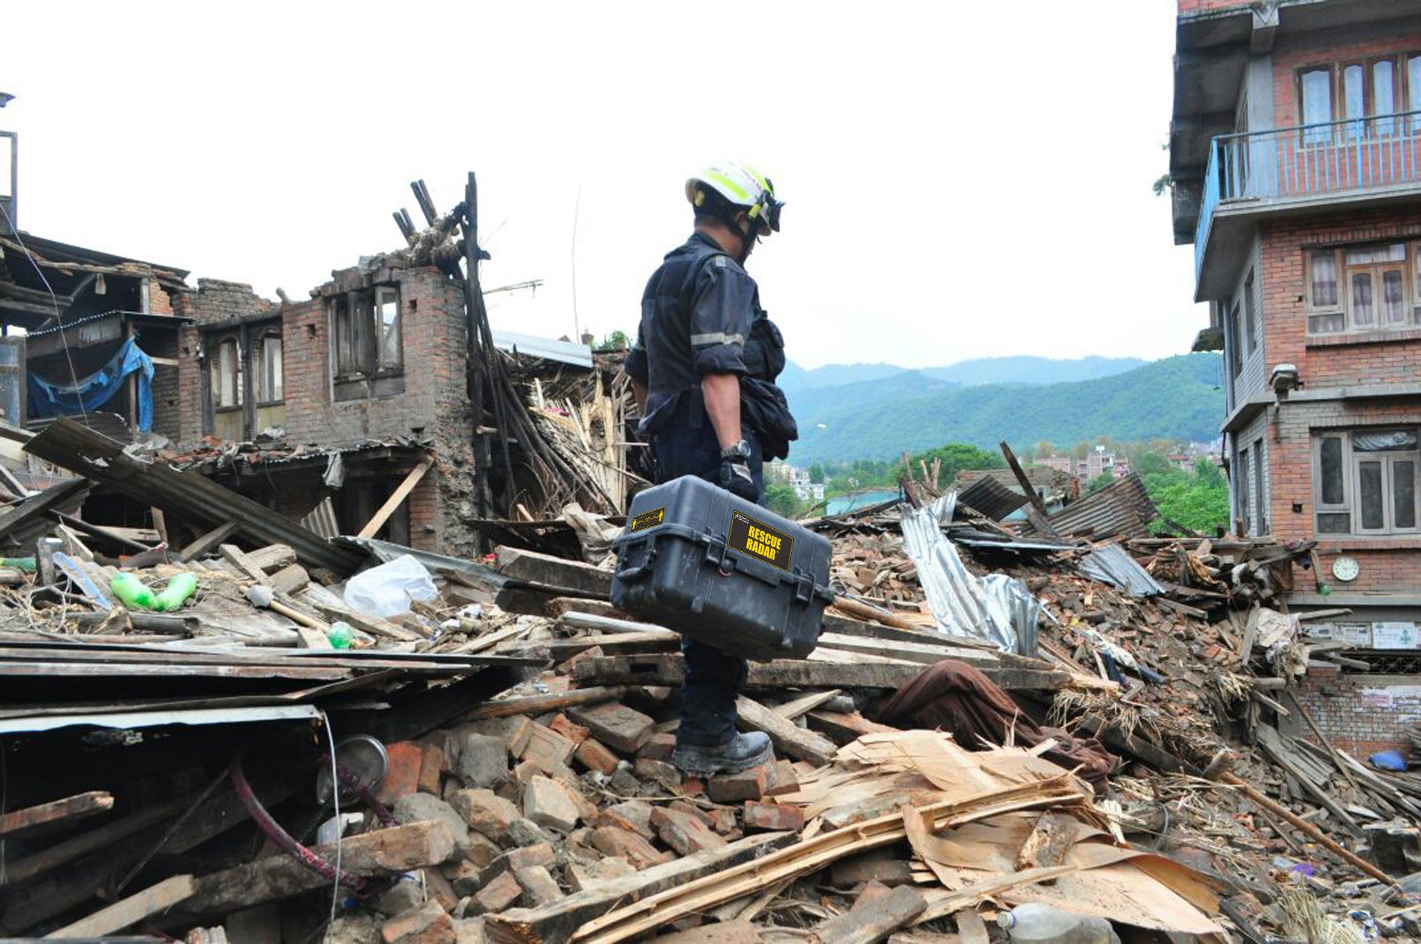
RESCUE RADAR
What is Rescue Radar?
Notes:
Introducing Conquest – for a keen eye in concrete imaging

Slide 4
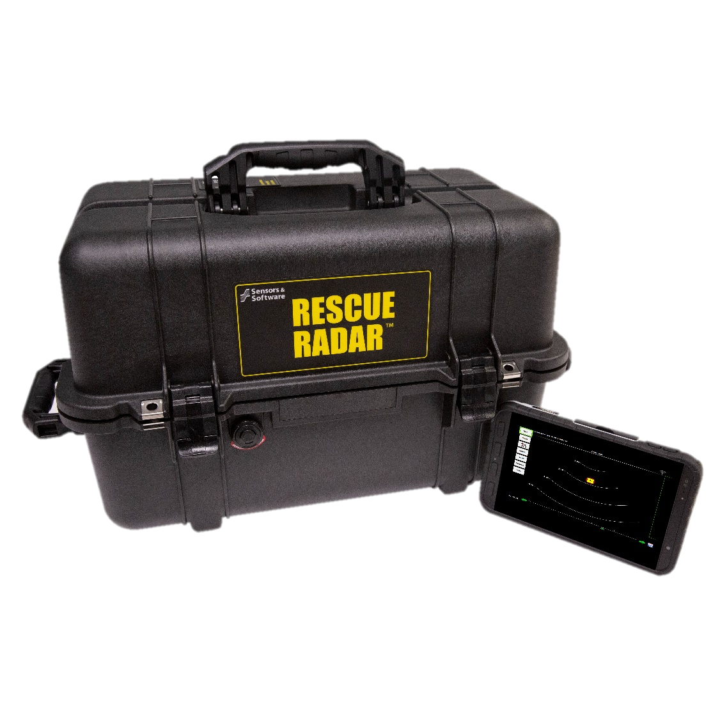
What is Rescue Radar?
Designed for Search and Rescue
Safe, quick, easy to use
Rapid on-site results

Slide 5
What is Rescue Radar?
Victim detection through rubble and solid material
Triangulation through grid-like survey
Time-Lapse mode allows monitoring of known victims

Slide 6
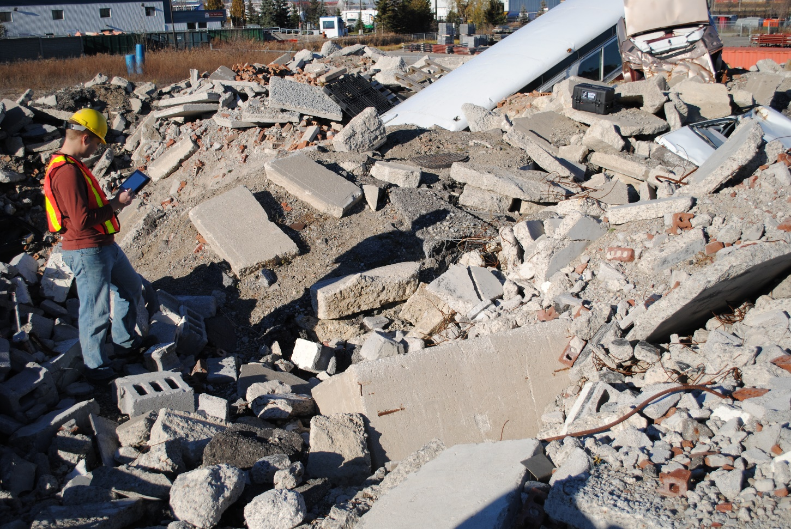
Rescue Radar Deployment
Operator stands > 50 feet away so their movement is not detected.

Slide 7
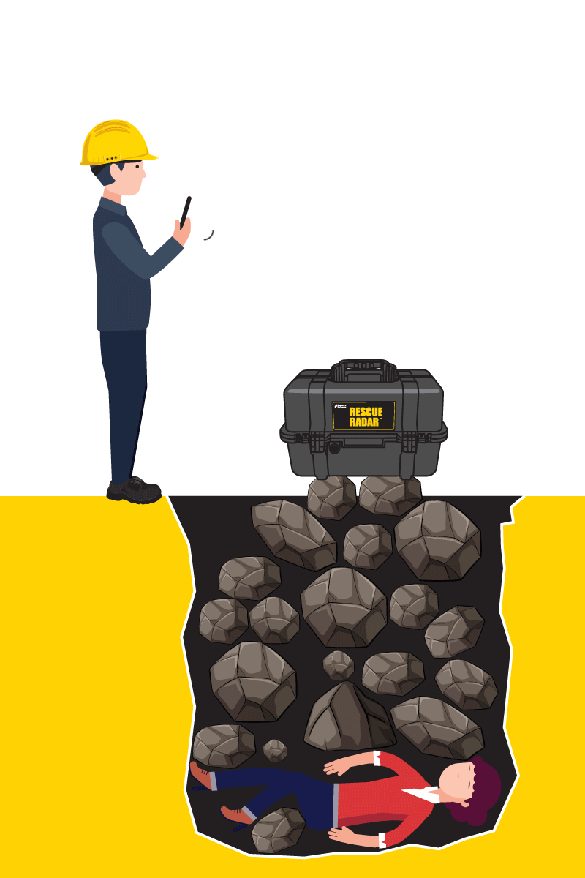
Simple Operation

Slide 8
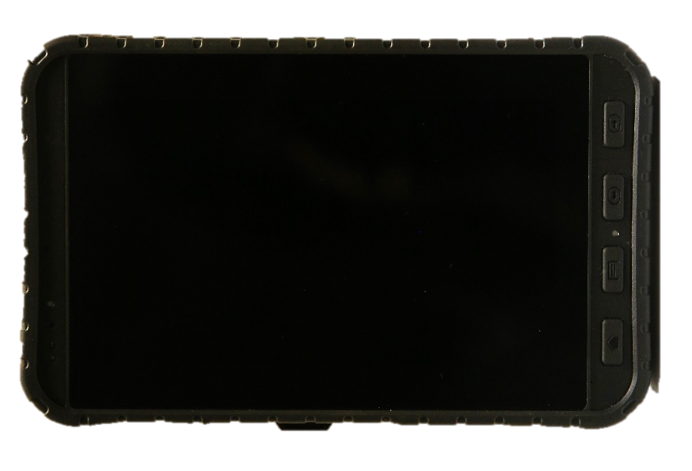
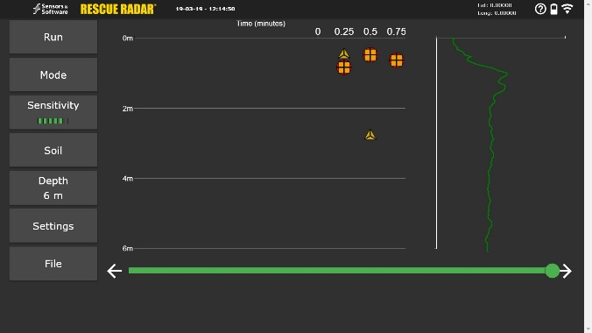
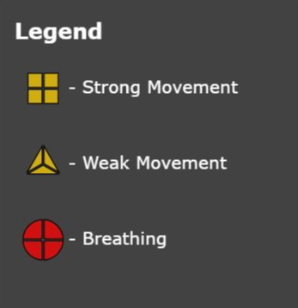
Quick Results

Slide 9
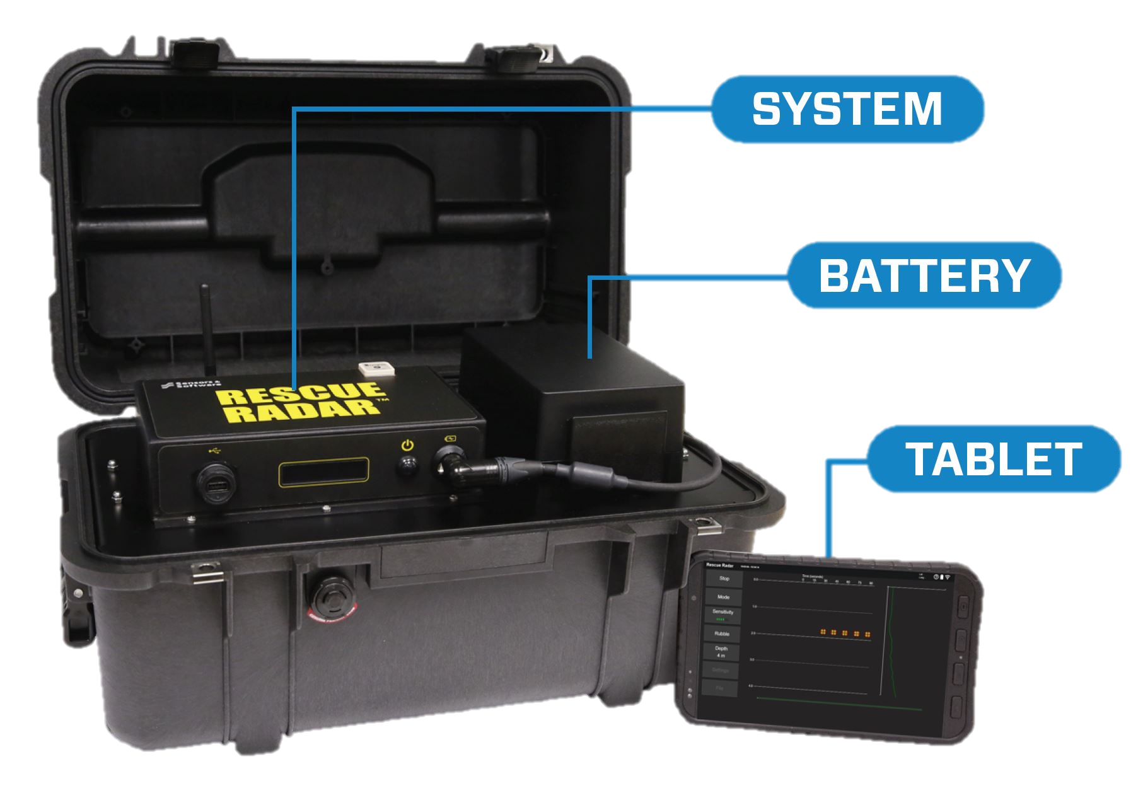
Rescue Radar Components
NIC-500R
Battery

Slide 10
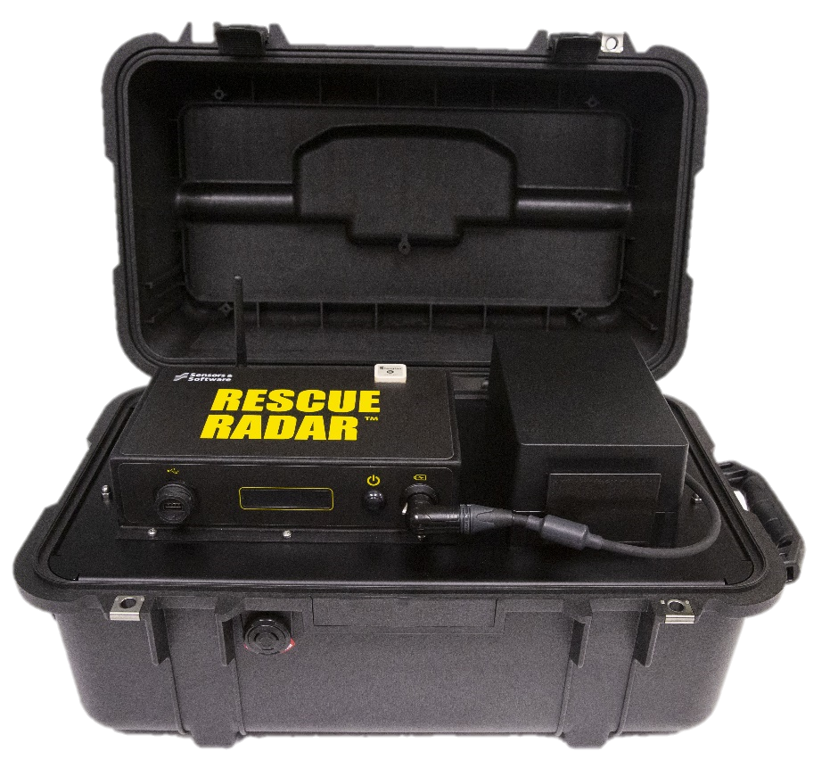
Rescue Radar Components
Built in GPS receiver for geotagging of results
75m Wi-Fi Range
Rechargeable battery
Built-in transport and protective weatherproof case
3rd Generation
Rescue Radar System

Slide 11
Rescue Radar Interface

Slide 12
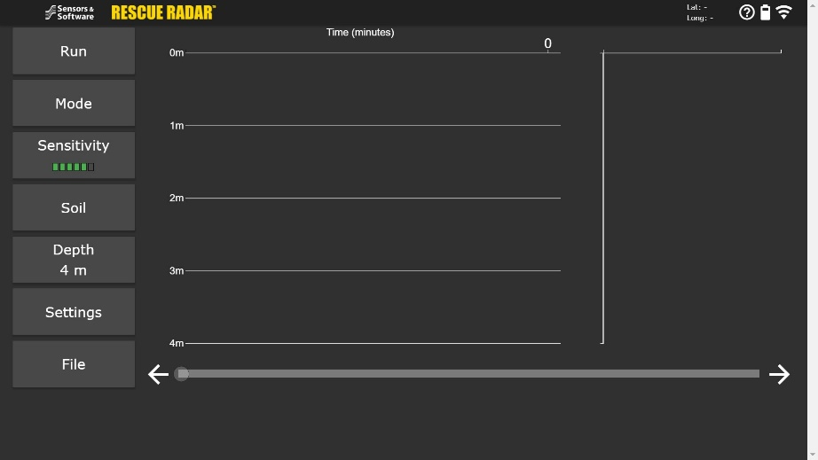
Home Screen
Same layout with added features that are easily accessible

Slide 13
Mode
Basic Mode
Displays a single reading and refreshes after a set cycle length

Slide 14
Material
Toggle between the material (Air, Snow, Rubble or Soil) being scanned with preset velocities for accurate depth to target
Notes:
Tog

Slide 15
Depth
Adjust the depth range that is displayed on the screen during data collection or playback

Slide 16
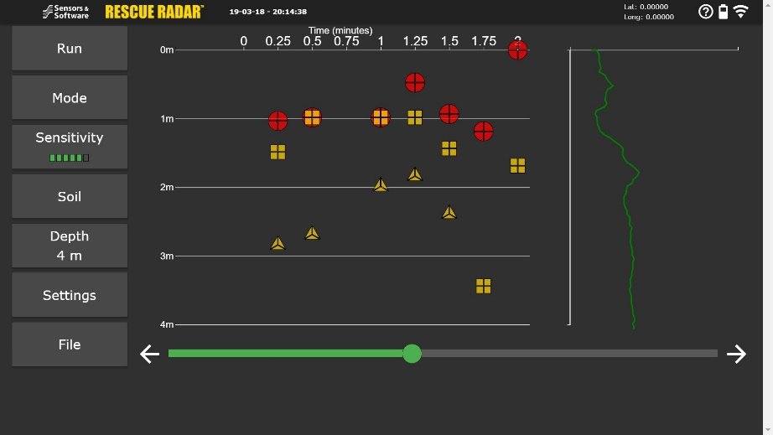
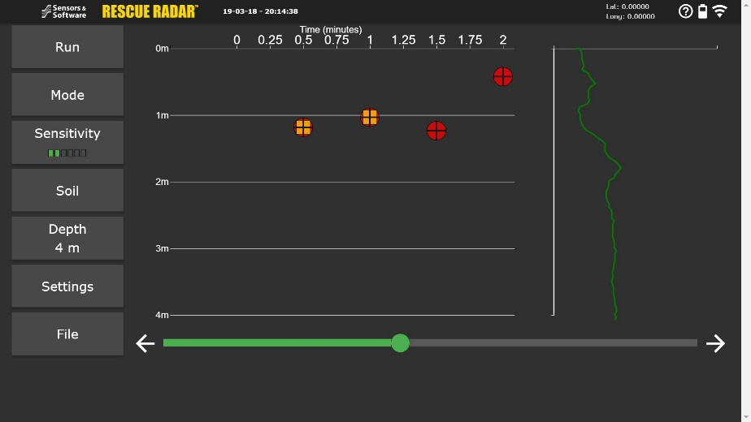
Sensitivity
Adjust the Sensitivity level from 1 to 6 on the fly during data collection or playback depending on your requirements

Slide 17
Mode
Time Lapse Mode
Displays up to 10 consecutive readings at once taken a set cycle length

Slide 18
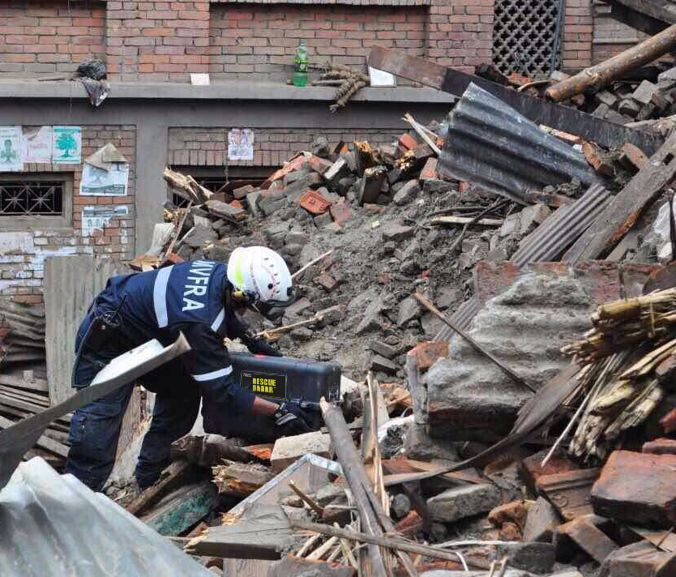
Practical Considerations
Ground Coupling
Ensure that the radar unit is well seated to ensure maximum signal
Do not place on exposed metal
Ensure radar unit will not move during data collection

Slide 19
Practical Considerations
Materials
Air
Wood
Snow
Sand
Soil
Non-reinforced concrete
Mixed rubble
Reinforced concrete
Clay Soil
Heavily reinforced concrete
Mixed rubble with large quantities of metal
Good Penetration
Poor Penetration

Slide 20
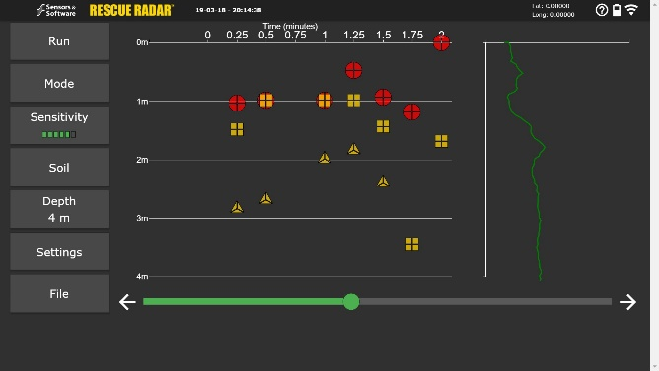
Practical Considerations
Sensitivity Setting
Multiple sensitivity levels are available to optimize data in individual circumstances
Easiest set in Time Lapse mode
A low sensitivity may not show any targets, while a high sensitivity may show false positives

Slide 21
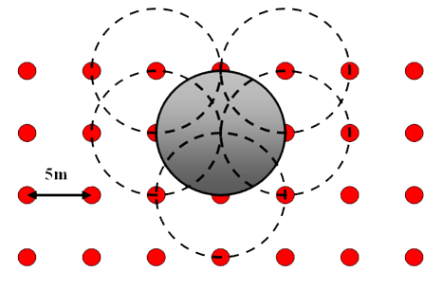
Practical Considerations
Survey Type
Collect data either in a structured grid survey, or in individual targeted location
Targeted scans can give quick results at sites that have been determined to be more likely of interest

Slide 22
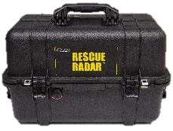
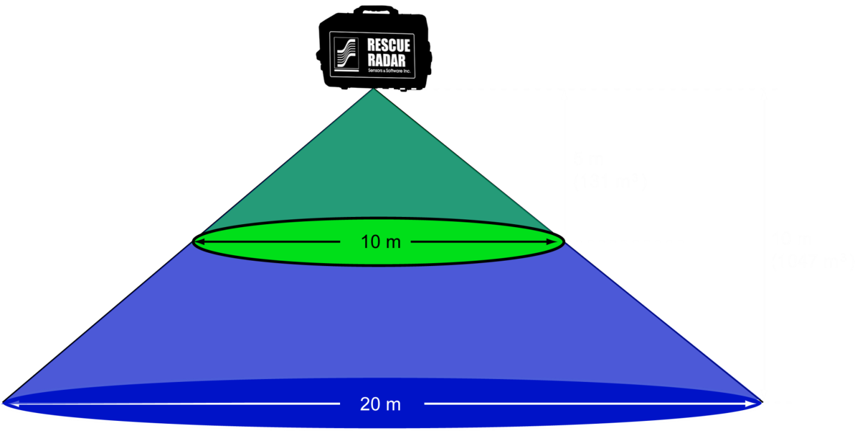
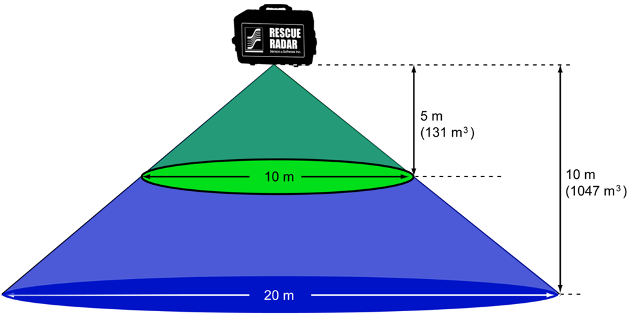
Practical Considerations
Grid Survey:
In this method, Rescue Radar is used to probe for movement in a regular pattern, typically with 5 meters between locations

Slide 23
Limitations
GPR cannot penetrate metal, making heavily reinforced material difficult to survey
Depth is approximate, based on the selected material type
False positives can occur, especially if rescuers or objects are moving within a 15 meter radius

Slide 24
Benefits
Can be deployed within minutes
Safe!
Uses radio waves similar to FM radio stations
Operate in a wide variety of environments
Non-destructive

Slide 25
Questions?

